Slide 1
Welcome
Richard Le
Teen Services Librarian
Notes:
Beginning course details and/or books/materials needed for a class/project.

Slide 5
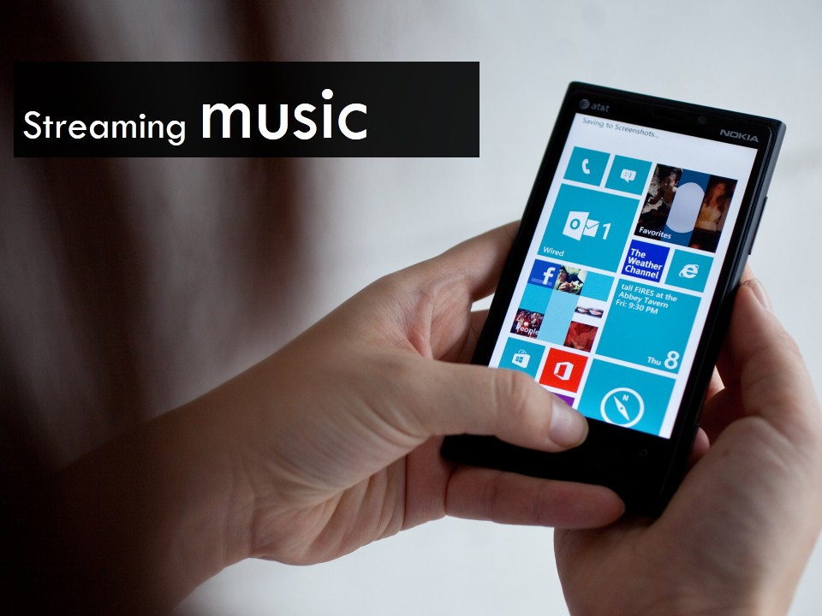

Slide 13
