Slide 1
Geary Bus Rapid Transit Project Presentation to the San Francisco Youth Commission
May 23, 2016

Slide 2
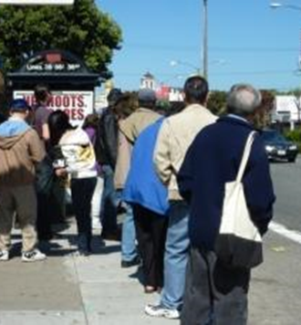
Why Geary?
50,000 daily passengers
Nearly as many as Caltrain!
Buses are slow, unreliable, and crowded
Mixed traffic
Double parking
Insufficient space at bus stops
High-injury corridor
390 injury collisions between 2005-2011 (7 times more likely to have an injury collision than rest of city)
Buses difficult to board

Slide 3
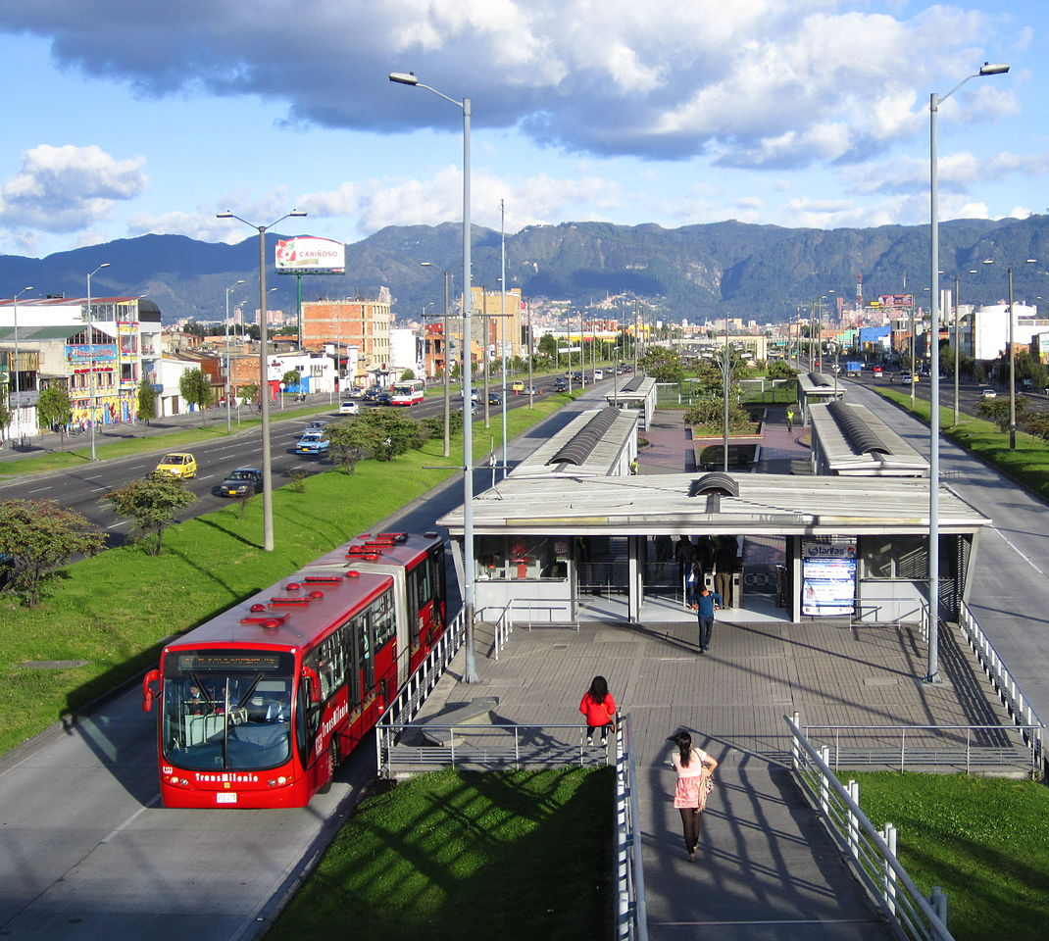
What is BRT?
Dedicated transit lanes
High-quality stations
Improved streetscape, safety, and accessibility
Why BRT, why not rail?
Fraction (1/10th) of the cost
Quicker implementation
High performance and big benefits
Bogota Colombia TransMilenio

Slide 4
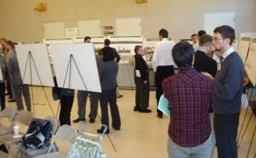
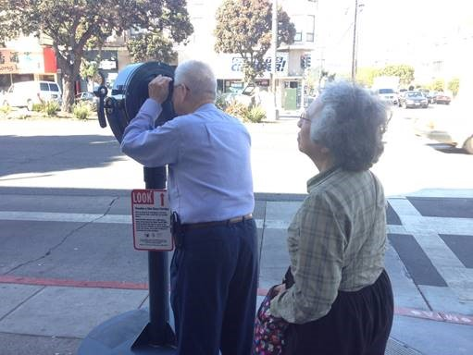
Community Input
A snapshot of Past Engagement
Major public meetings held
Summer 2012: update on alternatives
Winter 2013/14: selection of staff-recommended alternative (SRA)
Fall 2015: draft environmental document release
Over 200 community presentations provided to stakeholders along the corridor
Regular Geary Citizens Advisory Committee Meetings with representatives from across the corridor
Geary corridor visitor survey conducted in 2013
Merchant door-to-door survey conducted in 2013
Regular web, email, and social media project updates
Ongoing working group meetings

Slide 5
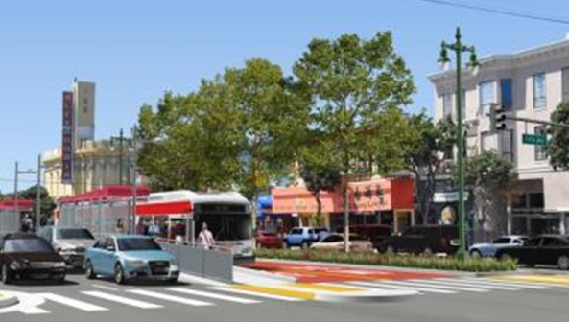
What will BRT do for Geary?
Project Features
Major transit service benefits
Improvements impact both local and Rapid service
Up to 20-25% travel time-savings
Up to 20% more reliable service
Helps service all day, not just rush hour
Larger, more accessible stations
Pedestrian safety improvements
Complete street benefits everyone

Slide 6
Overview of Proposed Improvements
No bus lanes
Side
Center Lanes, Consolidated Stops
Side Lanes
Side Lanes (existing)
Sutro Heights
27th to 34th
Palm/Jordan to 27th
Masonic
Fillmore/
Japantown
Gough to Market
*Reflects Staff-Recommended Alternative
6

Slide 7
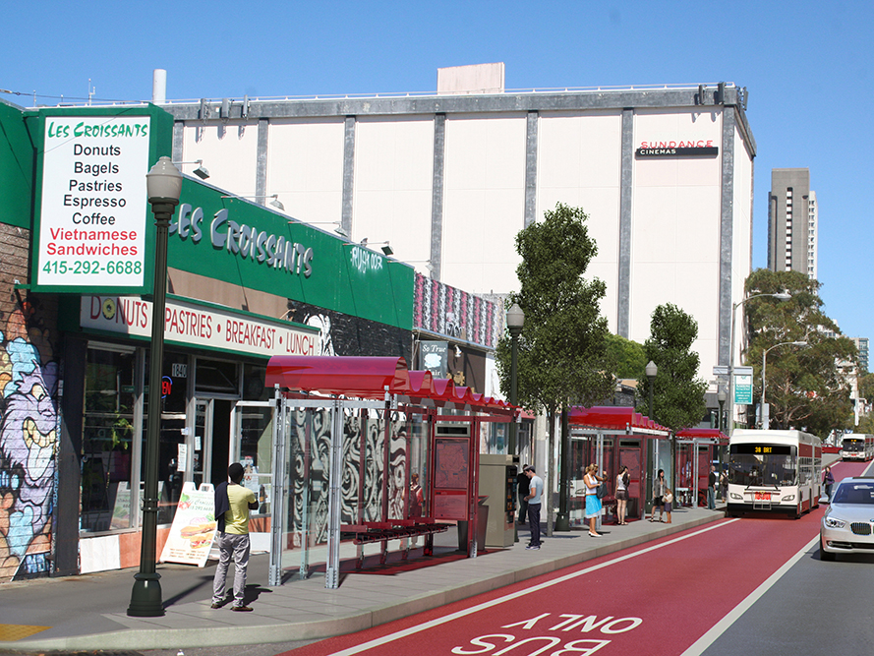
Side Lanes: Market St to Palm Ave
Example: Fillmore & Geary

Slide 8
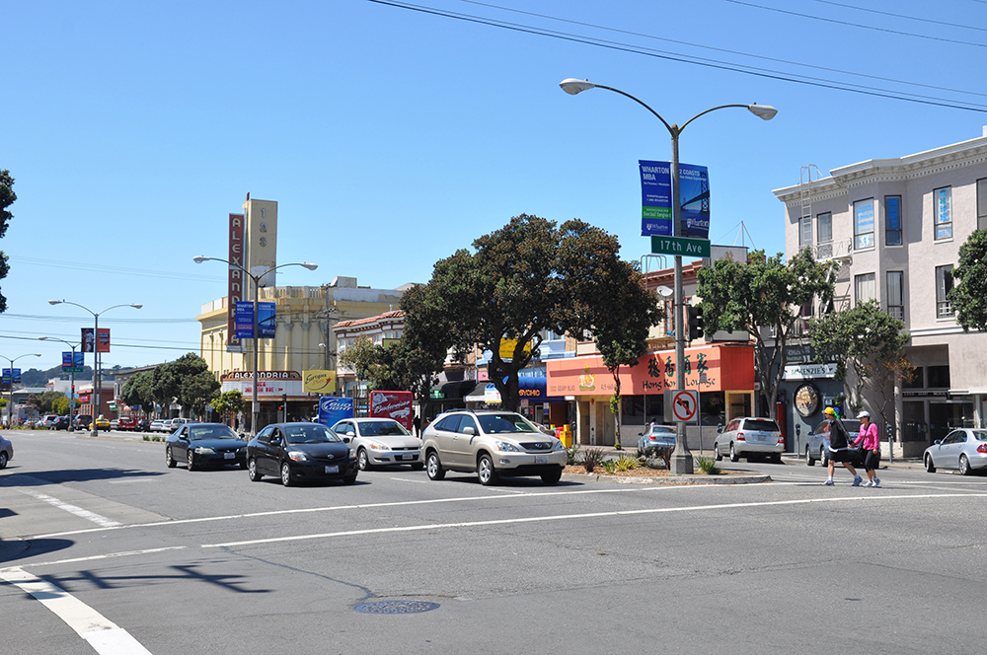
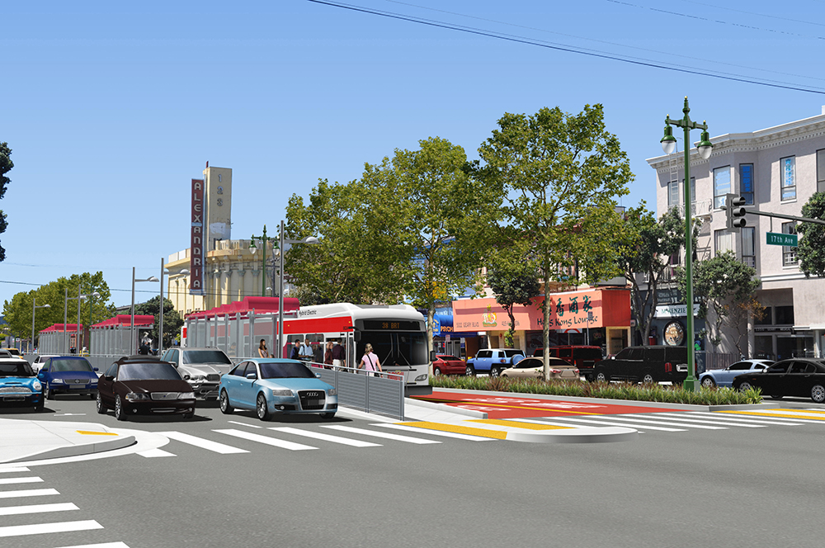
Center Lanes: Palm Ave to 27th Ave
Example: 17th Ave & Geary

Slide 9
Project Phasing
Phase 1 Near-Term Improvements: Market to Stanyan Streets (Beginning Late 2016)
Pedestrian safety improvements (e.g. sidewalk and signal work)
Bus stop and station enhancements
Painting of side-running transit-only lanes
Utility and pavement upgrades west of Van Ness
Phase 2: Stanyan – 34th Ave (Beginning Late 2019)
Center running transit-only lanes Palm to 27th Ave
New medians and station platforms
Pedestrian safety improvements (e.g. sidewalk and signal work)
Utility and pavement upgrades
*Timeline Subject to change
9

Slide 10
Approval Actions *Subject to change
Late Summer 2016
- Public release of final Environmental Impact Study/Report
Early Fall 2016
- Geary Citizen Advisory Committee takes action
Fall 2016
- Transportation Authority Board takes action
- SFMTA Board takes action
- FTA Approval
Winter 2016
- Phase 1 improvements constructed

Slide 11
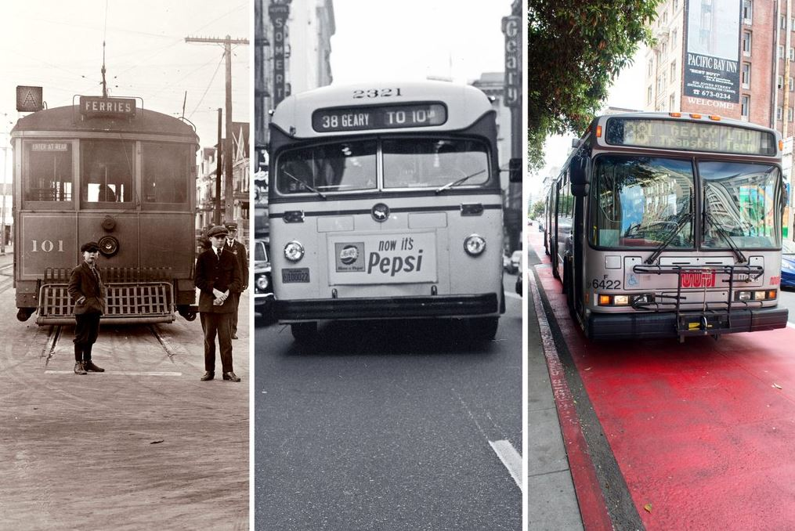
Questions?
11

Slide 12
For More Information: CONTACT Colin Dentel-Post, Geary BRT Project Manager colin.dentel-post@sfcta.org Gearybrt.org
April 14, 2016

