Slide 1

Lead Agency:
San Francisco Child Abuse Prevention Center
Partner Agencies:
-APA Family Support Services
-Instituto Familiar de la Raza
-OMI Family Resource Center
SafeStart
Collaborative
Notes:
Our partners include: APA Family Support Services; Instituto Familiar de la Raza and at the OMI Family Resource Center.

Slide 2
Notes:
SafeStart advocates are located throughout the city. Our main office and partner agencies are located in various neighborhoods highlighted in green. However, all our partners are very mobile and often times will meet families in other locations that is most convenient for them.

Slide 3
Other Partners:
San Francisco Police Department: Special Victims Unit (SVU)
United Family Court
Child Trauma Research Program
District Attorney’s Office: Victim Services Division
Notes:
Aside from working with various family resource centers. We also have a strong partnership with the San Francisco Police Department. We regularly pick up police reports from the Special Victims Unit and offer our services to families who qualify for our program. We also work with United Family Court and receive referrals for families who may be interested in our services. And since the inception of our program, SafeStart has had a strong partnership with the Child Trauma Research Program. For many years, we worked with CTRP to provide our advocates with support with guidance in our case consultations and ongoing trainings from folks who are the leading experts in working with children who are dealing with trauma. And lastly, SafeStart also works with Victim Services from the District Attorney’s office. We specifically work together to promote the Child Witness Program that offers up to $5000 for child or youth to pay for mental health services if they witnessed a violent crime.

Slide 4
Who qualifies for safestart services?
-Must reside in san francisco
--must have at least 1 child between the ages of 0-6 years old
-must have been exposed to some form of violence

Slide 5
SafeStart Core Services
Intensive Case Management
& ongoing psycho-education
Superheroes Group
10-week
Parent & Child
skill-building group
Adults and Children Together (ACT)
Against Violence
8-week Parenting Class

Slide 6




Protective Factors
Parental Resilience
Concrete Support in Times of Need
Knowledge of Parenting and Child Development
Social and Emotional Competence of Children
Nurturing & Attachment
Social Connections

Slide 7
How do we define “exposure to violence”?
Witness violence (domestic / community)
Hear violence from another room
Direct victim of child abuse or neglect
Exposure to the aftermath
Notes:
And lastly, we define violence as a child who may be exposed to the aftermath of an incident at home. For example, a child who comes home to a house that is torn up after a violent fight, or seeing a parent’s injuries, or by hearing their parents argue either in front of them or in another room.

Slide 8
Why are we concern?
Neurobiological Development
Development / Cognitive Development
Behavioral Impacts
Long-term effects on their health
Notes:
Most households with domestic violence have children living in them. Despite mothers’ best efforts to shield their children from violence, 68-87% of domestic violence incidents are witnessed by children. Children can be deeply affected by the violence they witness, and may develop a view of the world as a dangerous place – this in turn affects how they function and interact with others.

Slide 9
How to help families :
Screening for violence
Be careful to not blame the parent
Validate their experience and thank them for sharing
Provide families with resources and refer families for help
What can I do?

Slide 10
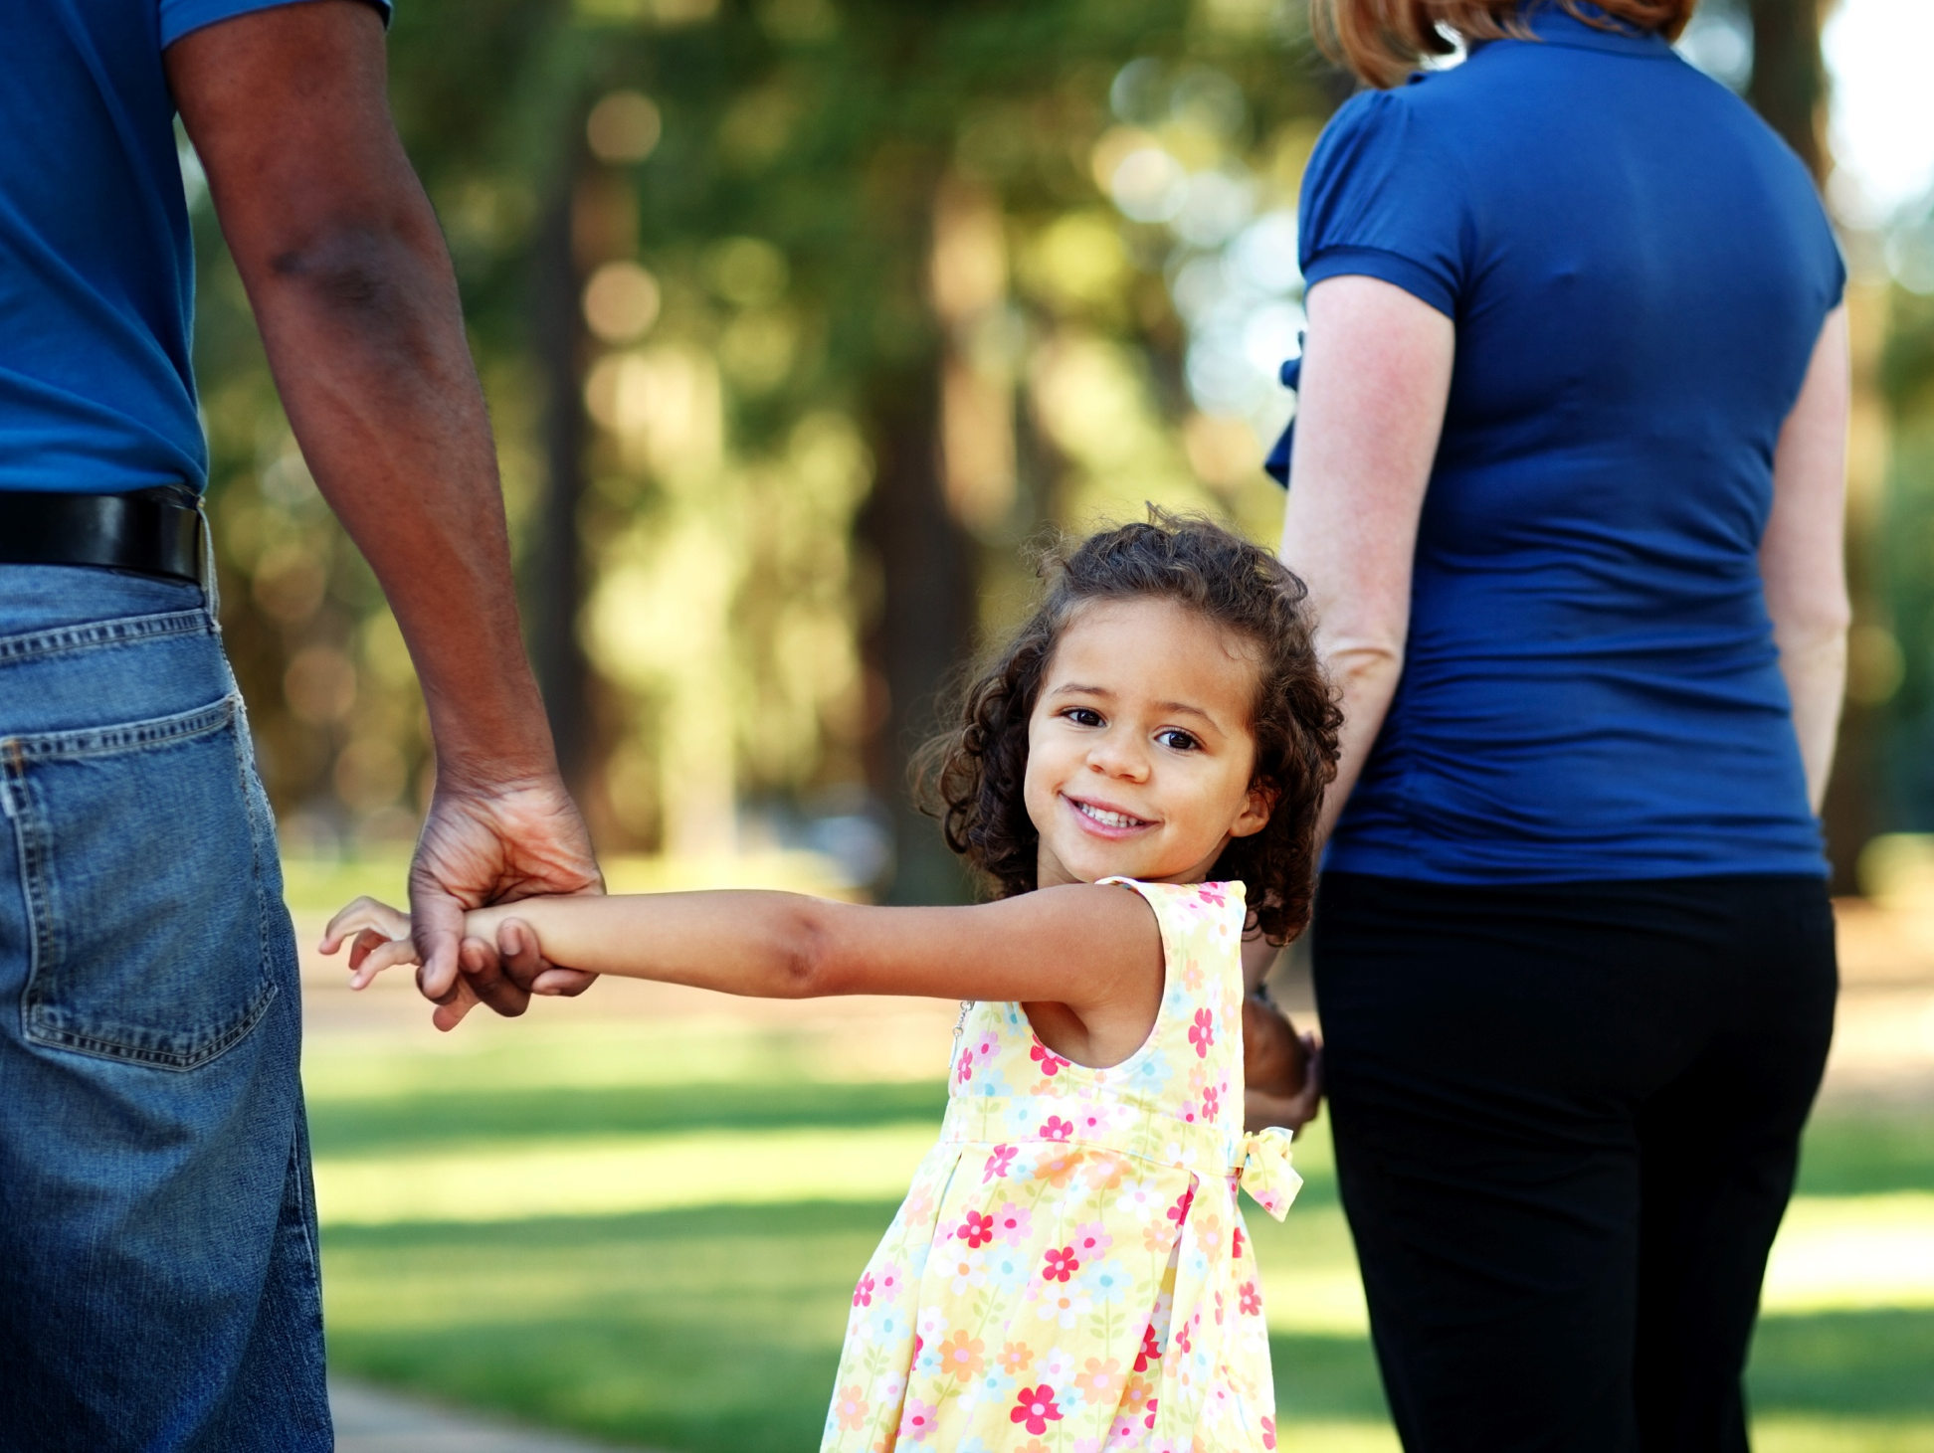
Most importantly…
…let families know that they are not alone and that there is help available.

Slide 11
For more information about Safestart or to refer a family for services please contact: blia Moua at safestart@sfcapc.org or call
(415) 668 - 0494 ext. 441

