Slide 1

Social Determinants of Health and Asthma
Dayna Long, MD
San Francisco Asthma Network Forum
10/10/14
Notes:
Hello, My name is Dayna Long. I am a pediatrician at UCSF Benioff Children’s Hospital Oakland, Ca. UCSF Benioff Children’s Hospital Oakland is a premier, not-for-profit medical center for children in Northern California, and is the only hospital in the East Bay 100% devoted to pediatrics. 70% of the families that we serve have government insurance. 50% of our families are either Black or Latino, Our families speak 58 different languages. In 2013, we had 250,0000 visits.

Slide 2
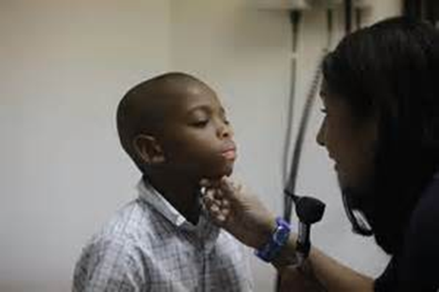
Objectives
1. To define Social Determinants of Health and the relationship to health inequities
2. To understand Adversity and Toxic Stress
3. To discuss new research projects
4. How care health providers screen and offer anticipatory guidance

Slide 3
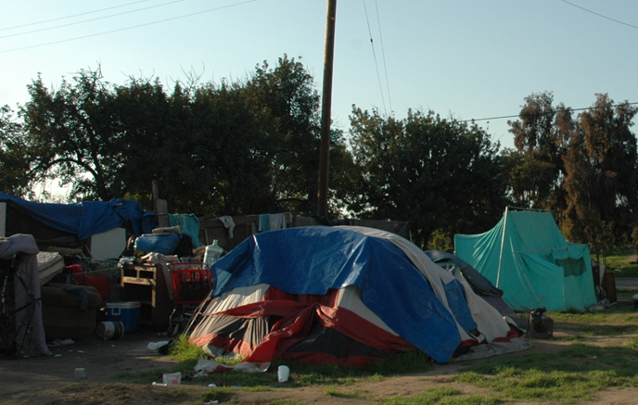

_{Social Determinants of Health}
Where children live, eat, sleep, play, pray and go to school profoundly impacts their health
Notes:
Social Determinants of Health
According to WHO:
“The circumstances in which people are born, grow up, live, work, and age, as well as the systems put in place to deal with illness. These circumstances are in turn shaped by a wider set of forces: economics, social policies, and politics.”
At UCSF Benioff Children’ s Hosptial Oakland we that
Health is more than healthcare
Health is tied to the distribution of resources
Poverty and economic and political inequality lead to poor health outcomes
The choices that our children’s (our patients’) make are shaped by the choices that they have
In the face of adversity we see resilence
The ACE Study is ongoing collaborative research between the Centers for Disease Control and Prevention in Atlanta, GA, and Kaiser Permanente in San Diego, CA. The Co-principal Investigators of The Study are Robert F. Anda, MD, MS, with the CDC; and Vincent J. Felitti, MD, with Kaiser Permanente. Over 17,000 Kaiser patients participating in routine health screening volunteered to participate in The Study. Data resulting from their participation continues to be analyzed; it reveals staggering proof of the health, social, and economic risks that result from childhood trauma.
-parent separation and divorce
-parental mental health
-substance abuse
ACE <4
drugs
alcoholic
heart disease
cancer
Diabetes
obesity
ACE >6
Die 20 years early.
Dr. Jack Shankoff at the Harvard Center on the Developing Mind reported that there are different kinds of stress.
Positive stress response is a normal and essential part of healthy development, characterized by brief increases in heart rate and mild elevations in hormone levels. Some situations that might trigger a positive stress response are the first day with a new caregiver or receiving an injected immunization.
Tolerable stress response activates the body’s alert systems to a greater degree as a result of more severe, longer-lasting difficulties, such as the loss of a loved one, a natural disaster, or a frightening injury. If the activation is time-limited and buffered social support the brain and other organs recover from what might otherwise be damaging effects.
Toxic stress response can occur when a child experiences strong, frequent, and/or prolonged adversity—such as physical or emotional abuse, chronic neglect, caregiver substance abuse or mental illness, exposure to violence, and/or the accumulated burdens of family economic hardship—without adequate adult support. This kind of prolonged activation of the stress response systems can disrupt the development of brain architecture and other organ systems, and increase the risk for stress-related disease and cognitive impairment, well into the adult years.
This kinds of SDOH, Adversity and Toxic Stress really get under your skin and lead to alternation in the way in which our genetic code is read, our hormonal axis functions and the degree of inflammation in our bodies. All of which profoundly and directly leads to poor health outcomes.

Slide 4

Social Determinants of Health
According to WHO:
  “The circumstances in which people are born, grow up, live, work, and age, as well as the systems put in place to deal with illness. These circumstances are in turn shaped by a wider set of forces: economics, social policies, and politics.”
Notes:
At UCSF Benioff Children’ s Hosptial Oakland we that
Health is more than healthcare
Health is tied to the distribution of resources
Poverty and economic and political inequality lead to poor health outcomes
The choices that our children’s (our patients’) make are shaped by the choices that they have
In the face of adversity we see resilence

Slide 5
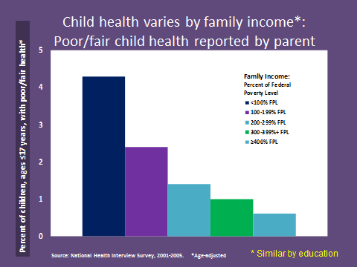
Health and Wealth
Notes:
This is the National Interview Study that looked at parents perception of their children’s health. What the researchers found was that parental persception was directly linked to SES. The wealthy the parent, the better they reported their childs health status and the poorer the parent the worse was the reported child health.

Slide 6
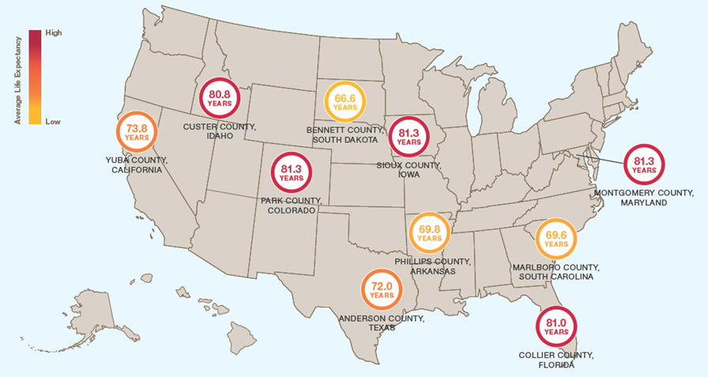
Social Determinants of Health
Across America, Differences in How Long, and How Well We Live
RWJF Commission to Build a Healthier America 2008
Notes:
Let’s look at life expectancy across this county. Life expectancy tends to be shorter in the states where 30% or more residents live in poverty area, mainly across the south.

Slide 7
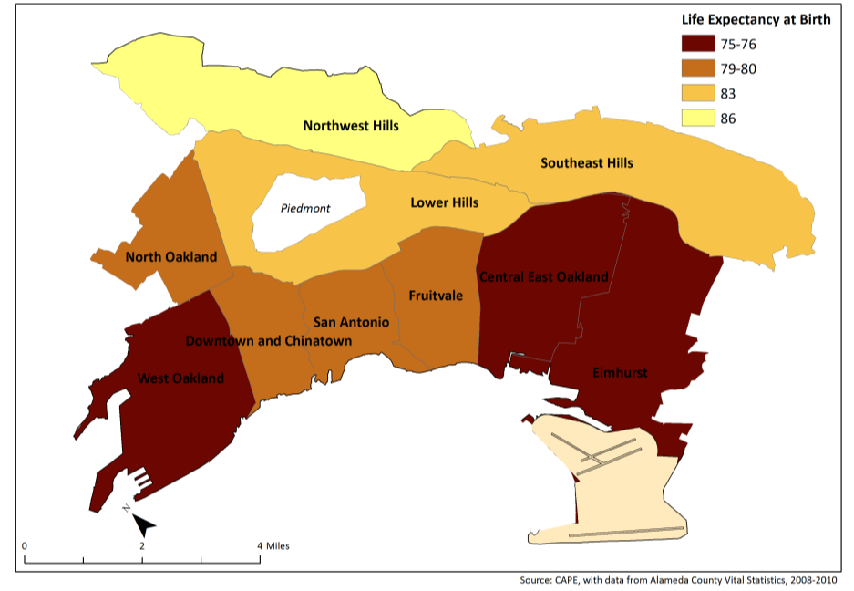
Just a few miles = Over a decade difference in LE
Alameda County Public Health Department, 2013
Notes:
If we zoom into Oakland, you can see how just a few miles distance can greatly impact life chances.
People living in the Northwest Hills can expect to live one decade or more longer than people living in West Oakland, Elmhurst, or Central East Oakland.

Slide 8

Compared to a White child born in the affluent Oakland Hills…
71
O
WEST OAKLAND
LIFE EXPECTANCY
O
OAKLAND HILLS
LIFE EXPECTANCY
85
…an African American child born in West Oakland can expect to live 14 fewer years.
Source: Alameda County Vital Statistics files, 2010-2012
Photo Source: The California Endowment, Health Happens Here
Notes:
We see even more disparate differences in life chances depending on place and race.
Compared to a White child born in the affluent Oakland Hills, an African American child born in West Oakland can expect to live 14 fewer years.

Slide 9
Compared to a White child in the affluent Oakland Hills, an African American child born in West Oakland is…
2 times more likely to be born low birth weight
13 times more likely to live in poverty
5 times more likely
to be unemployed
12 times less likely to have a mother who graduated from college
4 times less likely to read at grade level
3 times more likely to die of stroke
INFANT
CHILD
ADULT
Cumulative impact:
14 year difference in life expectancy
Source: Alameda County Death files, 2010-2012; Alameda County Birth files, 2009-2011; American Community Survey, 2007-2011; California Dept of Education, 2012-2013
Notes:
There are differences in opportunities for health and exposure to health risks that accumulate over the life course.
Compared to a White child in the affluent Oakland Hills, an African American child born in West Oakland is…
2 times more likely to be born low birth weight and 12 times less likely to have a mother who had the opportunity to graduate from college
As a child, 13 times more likely to live in poverty and 4 times less likely to read at grade level
And as an adult, 5 times more likely to be unemployed and 3 times more likely to die of stroke.
Over the life course, increased risks such as these have a cumulative impact of 14 years difference in life expectancy.

Slide 10
Neighborhood Poverty Level
(High Poverty)
*ED rates and neighborhood poverty are at the zip code level
Source: Alameda County OSHPD files, 2009-2011
Notes:
There are also higher levels of morbidity or disease burden in neighborhoods with higher poverty.
The rates of visits to the emergency department for diabetes, asthma, obesity, and assault are about 2-4 times higher in high poverty neighborhoods compared to affluent neighborhoods.

Slide 11

Adverse Childhood Experiences (ACES)
3 types
Abuse: phyical, emotional, sexual
Neglect: physical and emotional
Household Dysfunction: mental illness (depression), domestic violence, divorce, drug use, prison
Dube SR, Fairweather D, Pearson WS, Felitti VJ, Anda RF, Croft JB. Cumulative childhood stress and autoimmune disease External Web Site Icon. Psychom Med 2009;71, 243–250.
Notes:
The ACE Study is ongoing collaborative research between the Centers for Disease Control and Prevention in Atlanta, GA, and Kaiser Permanente in San Diego, CA. The Co-principal Investigators of The Study are Robert F. Anda, MD, MS, with the CDC; and Vincent J. Felitti, MD, with Kaiser Permanente. Over 17,000 Kaiser patients participating in routine health screening volunteered to participate in The Study. Data resulting from their participation continues to be analyzed; it reveals staggering proof of the health, social, and economic risks that result from childhood trauma.
-parent separation and divorce
-parental mental health
-substance abuse
Results: Persons who had experienced four or more categories of childhood exposure, compared to those who had experienced noneshowed a graded relationship to the presence of adult diseases including ischemic heart disease, cancer, chronic lung disease, skeletal fractures, and liver disease
Almost 2x risk for physical inactivty, obesity
2-4X risk for smoking, poor self-rated health, risky sexual behaviors ansd STDs
2-12x risk for ETOH, sustance abuse, depression and suicide attempts.

Slide 12




ACES >4
12.2 times as likely to attempt suicide
10.3 times as likely to use drugs
7.4 times as likely to be alcoholic
2.4 times as likely to have heart disease
1.9 times as likely to have cancer
1.6 times as likley to have diabetes
Notes:
If ACE>6, then you can expect to die 20 years earlier

Slide 13

What is Stress?
Positive stress response
Tolerable stress response
Toxic stress response
Jack Shonkoff. Harvard University Center on the Developing Child
Notes:
Positive stress response is a normal and essential part of healthy development, characterized by brief increases in heart rate and mild elevations in hormone levels. Some situations that might trigger a positive stress response are the first day with a new caregiver or receiving an injected immunization.
Tolerable stress response activates the body’s alert systems to a greater degree as a result of more severe, longer-lasting difficulties, such as the loss of a loved one, a natural disaster, or a frightening injury. If the activation is time-limited and buffered social support the brain and other organs recover from what might otherwise be damaging effects.
Toxic stress response can occur when a child experiences strong, frequent, and/or prolonged adversity—such as physical or emotional abuse, chronic neglect, caregiver substance abuse or mental illness, exposure to violence, and/or the accumulated burdens of family economic hardship—without adequate adult support. This kind of prolonged activation of the stress response systems can disrupt the development of brain architecture and other organ systems, and increase the risk for stress-related disease and cognitive impairment, well into the adult years.

Slide 14

Toxic Stress really gets under your Skin.
Notes:
Our experience has a profound affect on our DNA. Our experience changes the way in which our bodies read our genetic code.
There is a new field of medicine called epigenitics. Epigenetics is the study of heritable changes in gene activity that are not caused by changes in the DNA sequence. Changes are made that cause the organism's genes to behave (or "express themselves") differently.^{[3]}
The fact that our environment can change the expresssion on of DNA has HUGE ramifications. Our DNA does not change only in 100’s of 1000s of year by natural selection but within moments.

Slide 15

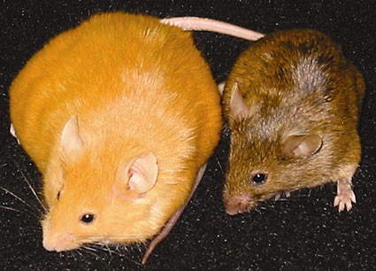
EpiGenetics
Notes:
The foundation question is, Is our experience hertiable?
This mice are genetic clones-they have the same DNA. Epigenetic changes have been observed to occur in response to environmental exposure—for example, mice given some dietary supplements have epigenetic changes affecting expression of the agouti gene, which affects their fur color, weight, and propensity to develop cancer, size, color, as well as the development of disease including diabetes and Chronic Lung disease
It is increasingly evident that epigenetic gene regulatory mechanisms play important roles in the etiology of human diseases.
The toxic stress from poverty, discrimination, and adversity changes our DNA and leads to poor health outcomes, decrease life expectancy, lack of finiancial success and barriers to academic achievement. The epigentic marks can then be passed down to our children.
People used to think that DNA was static. But life changes all the time. The epigentic code that controls DNA changes with us. Epigenitcs shows us that our experience-our stories, our narratives, echo over time down to our children.

Slide 16
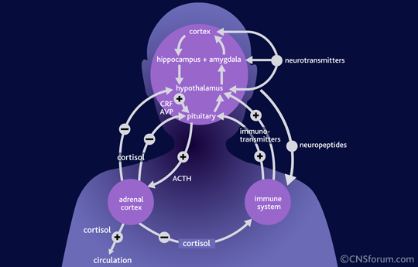
Hypothalamic-Pituitary Adrenal Axis
Notes:
Toxic stress leads to overactivation of the body’s stress response. When the body receives a stressor, the brain releases chemical messagers to the hypothalamus to release hormones that trigger the pituitary gland. The pituitary gland then releases hormones that stimulate the adrenal gland to produce adrenaline and cortisool. Toxic stress increases inflammation in the body. Inflammation is the common pathway for diseases such as asthma, diabetes and heart disease.

Slide 17
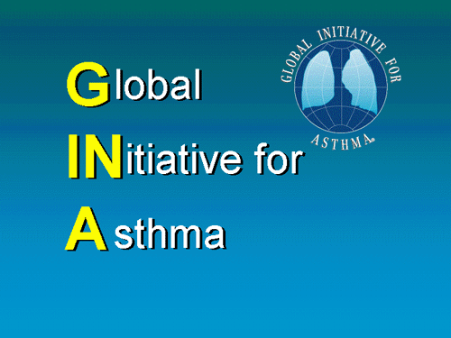
Inflammation
Genetic
Asthma
Environmental
INFLAMMATION
Bronchial
Hyperresponsiveness
Airflow Obstruction
Symptoms
Risk Factors
(for exacerbations)

Slide 18
Inflammation in Asthma
Allergen/Trigger
Mast cell
T-cell
Macrophage
Histamine
Cytokines
B-cell
IgE
Eosinophil
Airway Inflammation
.
Notes:
Inflammation in Asthma
The airway inflammation of asthma involves a variety of cells that are a part of the body’s immune and nonspecific defense mechanisms. We need to understand what some of these cells do on a molecular level and how they contribute to what is known as the inflammatory casade.
Mast cells and TH2 cells in the airway mucosa become sensitized by immunoglobulin E (IgE) and in turn induce the production of chemical mediators of inflammation such as histamine and leukotrienes and cytokines including interleukin-4 and interleukin-5.^{1,2}
IgE antibodies are activated during an allergic response. B-cells and T-cells are also involved in the immune response.^{1,2}
Eosinophils are a class of white blood cells that migrate to sites of allergic inflammation, where they release cytokines and chemical mediators. Prolonged activation and release of specific mediators can damage the airway epithelium.¹
Macrophages are nonspecific defense cells that are also found in the airway mucosa and secrete cytokines during inflammation.
Inflammation plays a central role in both the development of exacerbations and the long-term processes leading to irreversible airflow limitation in asthma.¹
Following sensitization in allergic asthma, exposure to an asthma trigger (i.e., allergen) creates a cascade of events in the asthmatic lung that ultimately result in airway inflammation. Eosinophils and mast cells are the two major cell types involved in acute inflammation. Mast cells and macrophages recruit other inflammatory cells, all of which communicate with each other by secreting cytokines, chemokines, and/or by stimulating the expression of adhesion molecules.^{1,2}
These processes lead to bronchoconstriction, edema, and increased mucus secretion, narrowing the airways and producing the symptoms of asthma.³

Slide 19
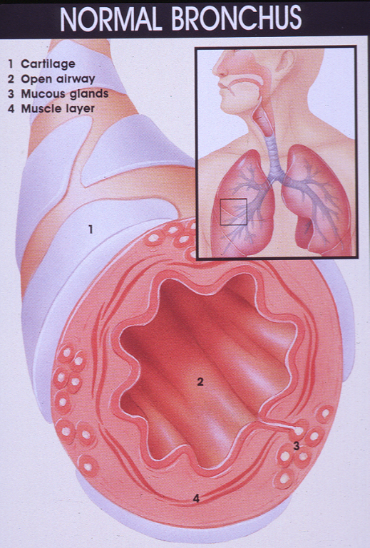
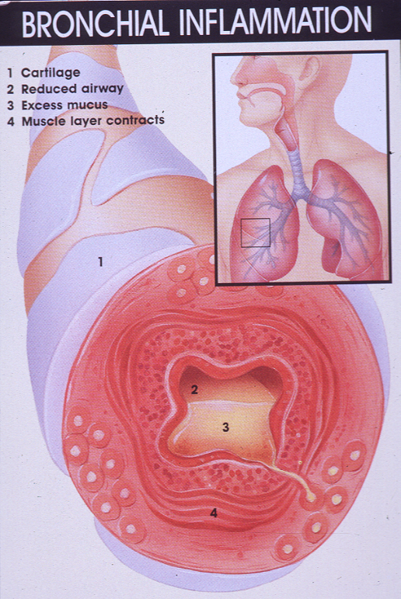
Inflammation
Notes:
The first and most important factor causing narrowing of the bronchial tubes is inflammation. The bronchial tubes become red, irritated, and swollen. This inflammation increases the thickness of the wall of the bronchial tubes and thus results in a smaller passageway for air to flow through. The inflammation occurs in response to an allergen or irritant and results from the action of chemical mediators (histamine, leukotrienes, and others). The inflamed tissues produce an excess amount of "sticky" mucus into the tubes. The mucus can clump together and form "plugs" that can clog the smaller airways. Specialized allergy and inflammation cells (eosinophils and white blood cells), which accumulate at the site, cause tissue damage. These damaged cells are shed into the airways, thereby contributing to the narrowing.

Slide 20


Aftermath of Inflammation
Reversibility
Remodeling
Notes:
This slide shows the difference between reversibility and remodeling.
Reversibility: after most asthma attacks the inflammation will decrease, the air returns to a more normal caliber and flow of air returns to normal.
After Multiple Attacks, the lungs remodel. Airway lining thickens and becomes fibotic and these changes last.
Asthma exacerbations or poorly controlled asthma can cause remodeling overtime.

Slide 21
In Alameda County
Notes:
26.6% of children 5 to 17 years in Alameda County have been diagnosed with asthma. Over 3x the national average
Over half of asthma hospitalizations (2004-2006) among children 5 to 17 years in Alameda County were paid for by Medi-Cal (53.8%). Poor children bear a disproportionate burden of asthma hospitalizations

Slide 22
Who gets Asthma?
Blacks experience
  more urgent care visits than Caucasians
  higher asthma attack prevalence rate (19.2%) than Caucasians
  higher rates of hospitalizations, 2.5 times greater than in Caucasians (Akinbami 2006).
  165 % higher death rates than Caucasians (Akinbami2006).
  Blacks of the same socioeconomic status and access to care still experience higher asthma morbidity (Gold)
  Blacks of the same socioeconomic status and access to care still experience higher asthma morbidity (Gold)
Notes:
Blacks bear a disproportionate burden of the morbidity of asthma as compared to Caucasians.

Slide 23

Inflammation
Less Reversibility and Response to Bronchodilators
In most asthmatics, 12% reserversibility in FEV1 after treatment with albuterol
In AA, less than 5-8% response.

Slide 24
BARD
Best African American Response to Asthma Drugs
The NHLBI’s AsthmaNet

Slide 25
BARD Major Research Questions
In Blacks with asthma >5 yrs, who are poorly controlled on low dose ICS, what is the preferred step-up therapy?
and
Does the degree of African ancestry affect preference for different therapies?

Slide 26
GIS
Ancillary Geographic Information System Protocol to Assess Environmental Effects on Drug Response for AsthmaNet Studies

Slide 27
GIS Objectives
To examine whether pre-existing chronic social and environmental exposures impact asthma treatment response
Look at air pollution, crime statistics, SE conditions and look at spatial correlations between exposures and asthma outcomes.
Notes:
Look at address, generate coordinates

Slide 28

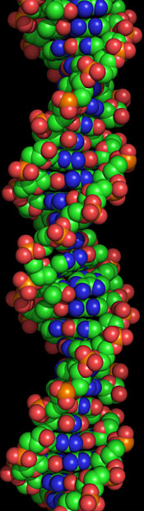
We see how early childhood experiences and stress are so important to lifelong outcomes and how the early social and environmental conditions literally becomes embedded in the brain, changes biologic function and then affect future generations.

Slide 29
So What Do We Do About This?
Research/Evaluation
Community Engagement
Technology
Improved
Health
Outcomes
Intervention/
Treatment
Prevention
Screening
Clinical Best Practices
Policy/Advocacy
Training/Education
Notes:
Where do we intervene and how do we intervene
Robert Wood Johnson
Story of where to jump in the water.

Slide 30

Social Determinants of Health Approach to Medicine
1. Improve population health
2. Decrease Health Care Costs
3. Improve health care efficiency
SFGate11.26.13

Slide 31

Thank You

