Slide 1
sfindicatorproject.org
of 20
Notes:
The majority of the City is yellow, meaning that no more than 4% of housing is designated as “affordable” , also called “below market rate” . Only one area, Bayview Hunters Point, has a significant amount of BMR housing.
Even for those units, there is no one-stop shopping and each affordable development has its own income eligibility requirements per unit, which I will show on the next slide.

Slide 2
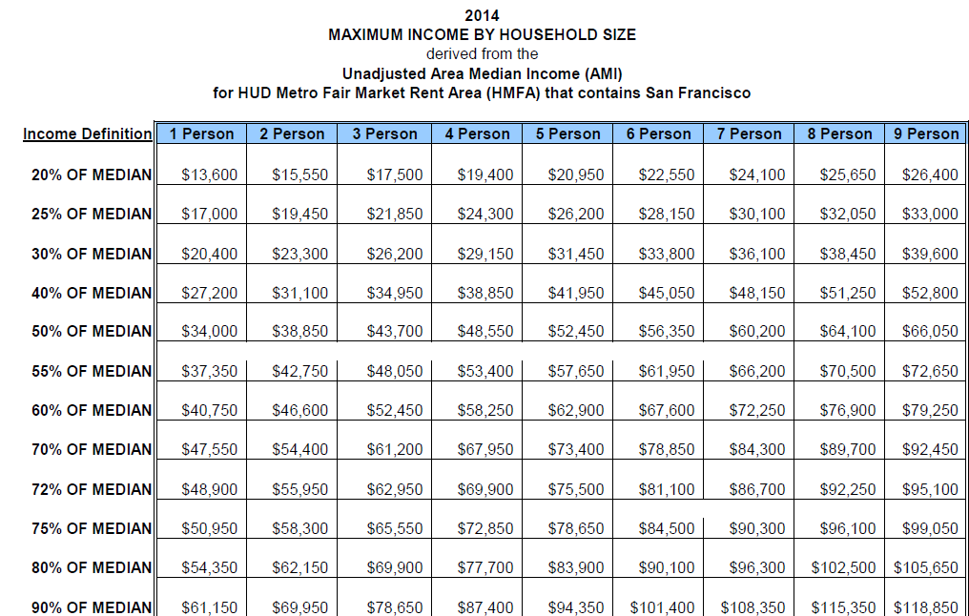
http://www.sf-moh.org/index.aspx?page=130
Notes:
Our area median income (or AMI) is quite high, so a low-income family is often competing for affordable housing with those who make much more.
For example, in the highlighted square, we see that 60% AMI means that a family of 4’s income must be:
no more than $58,250/year
In contrast, WIC eligibility for a family of 4 in CA is:
$44,123/year, and
Average self-reported income for the WIC families we visited is: $20,408/year

Slide 3
sfindicatorproject.org
of 20
Notes:
This map is based on Craigslist rental listings in late 2012, and shows how many minimum wage jobs are needed for rent.
In the lightest shaded areas, 3-4 minimum wage jobs per household are needed.
But in the darkest areas of the map, twice that number, 7-8 minimum wage jobs per household are needed.

Slide 4
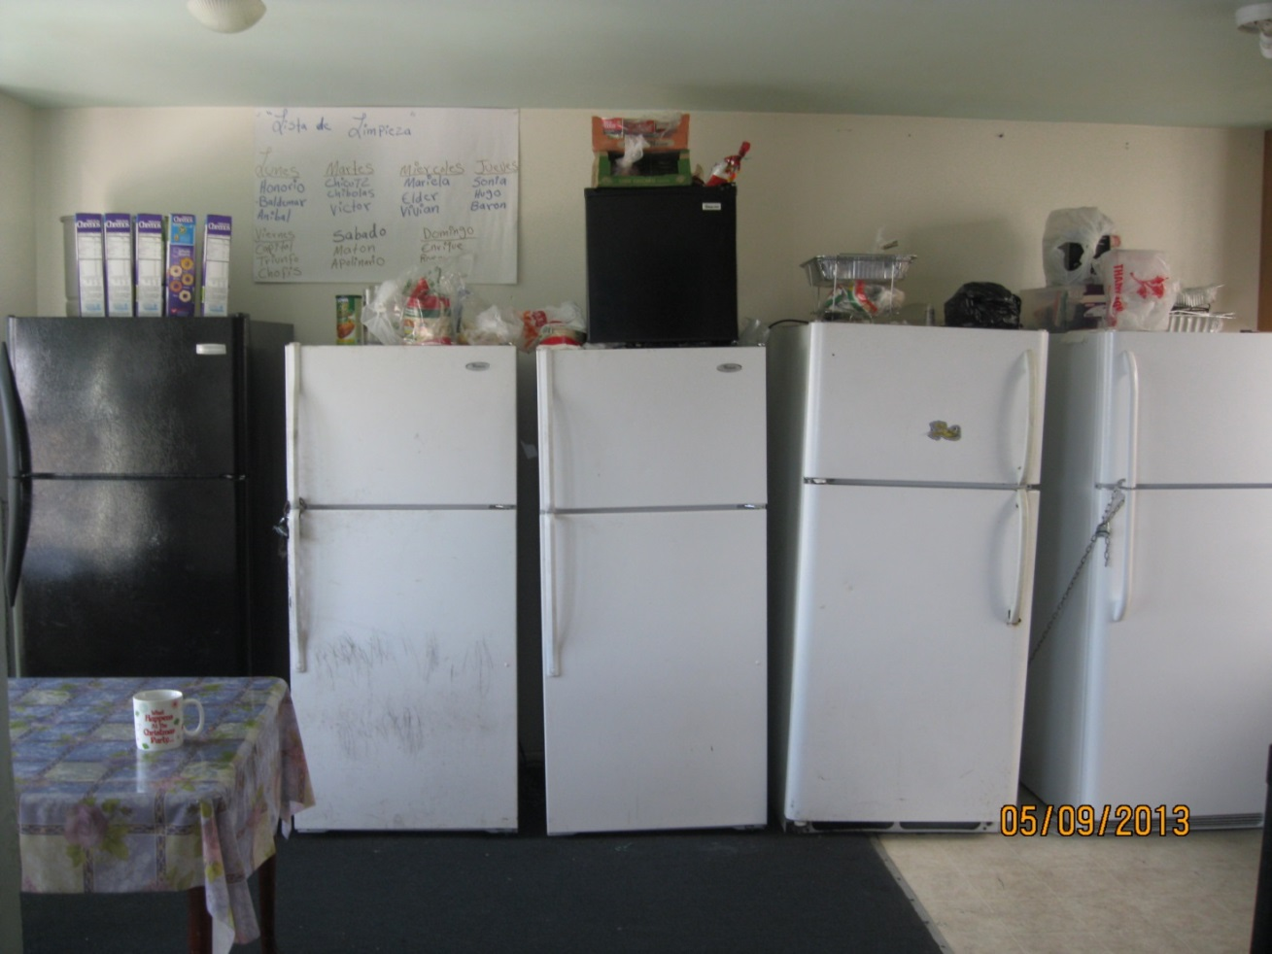
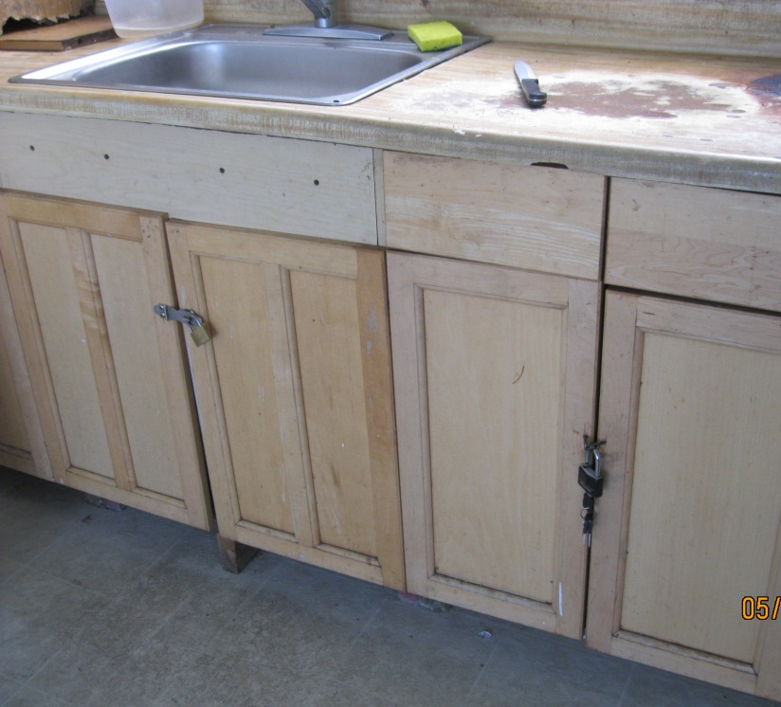
Notes:
Those are the factors that lead to this type of co-tenancy. The WIC families we visited universally named overcrowded living conditions as their main stressor.
In rental flats, we frequently see 5-6 families, each occupying one room of the flat, sharing kitchens and bathrooms, having everything under lock as shown here.
We also see families living in residential hotels in SRO rooms, meaning those designated for single person occupancy. In these hotels, many units share kitchen, toilets and shower rooms.

Slide 5
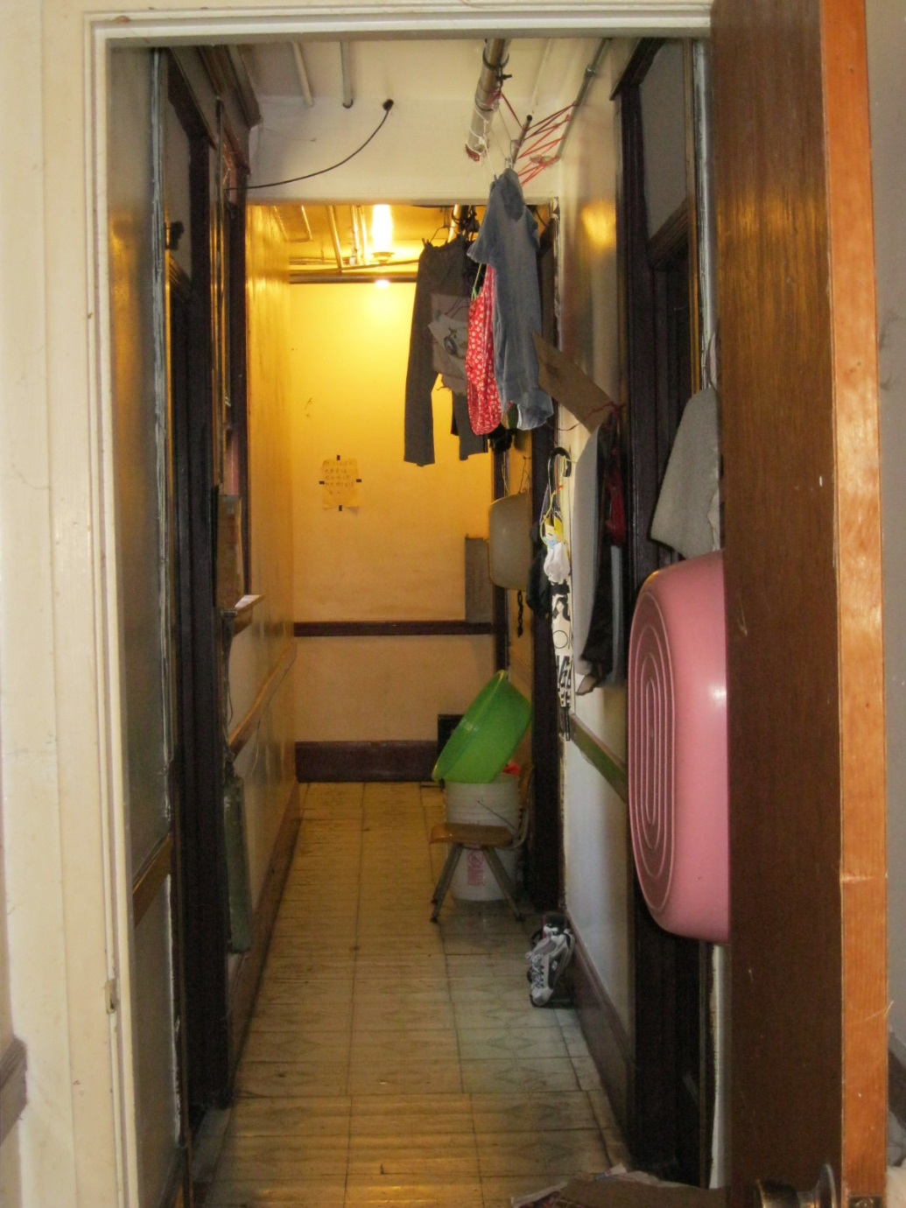
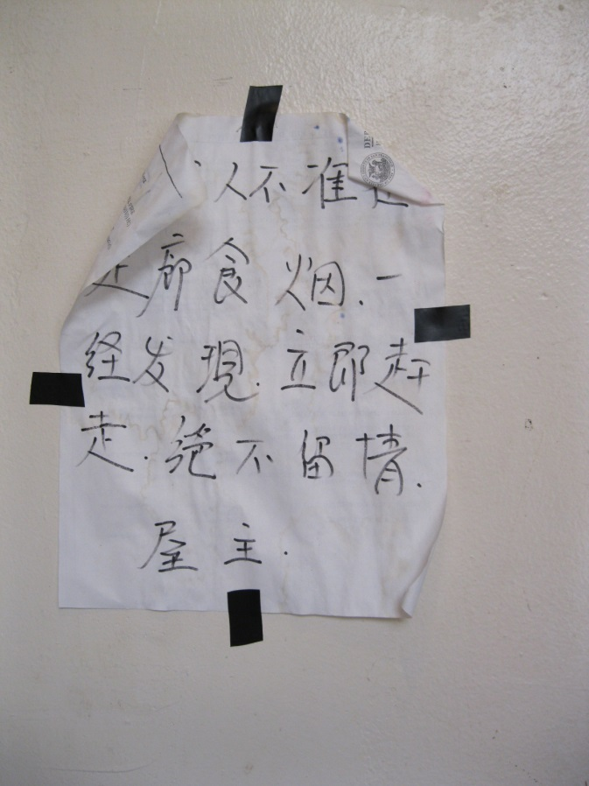
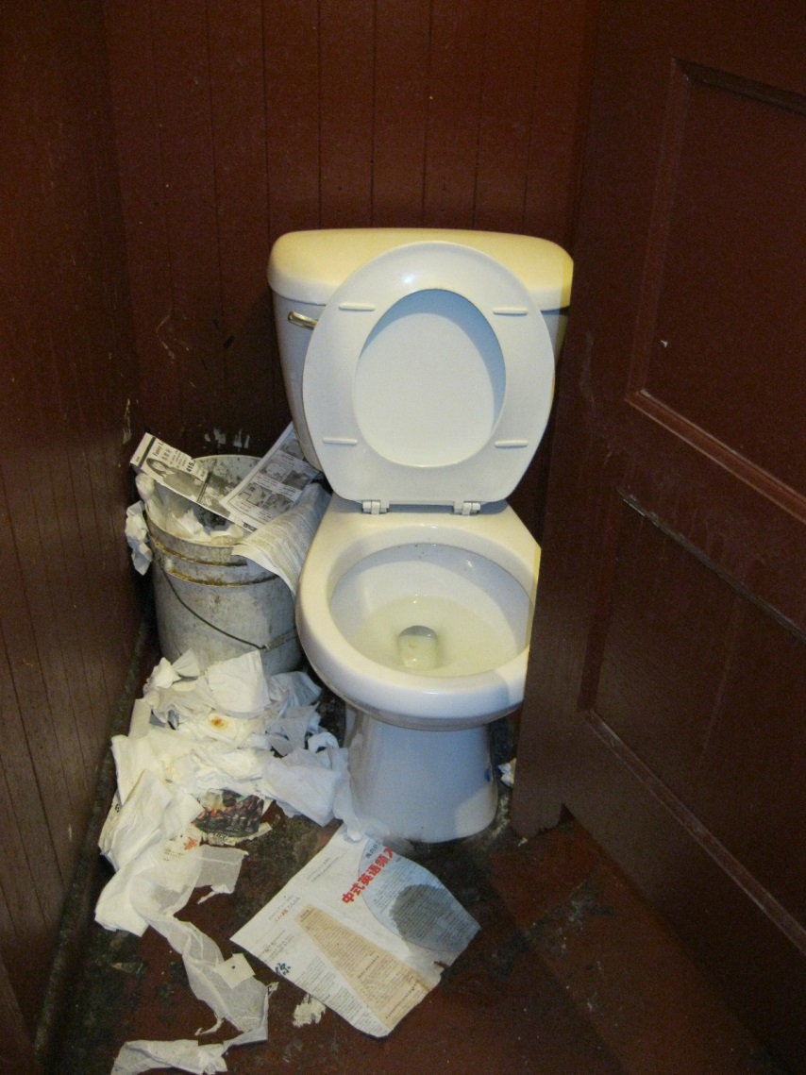
Notes:
SRO conditions such as:
Storage of personal property and laundry in common hallways due to small size of living space per family;
Two toilets for all units on the floor; bring your own toilet paper; sign says you will be evicted for smoking in toilet room

Slide 6
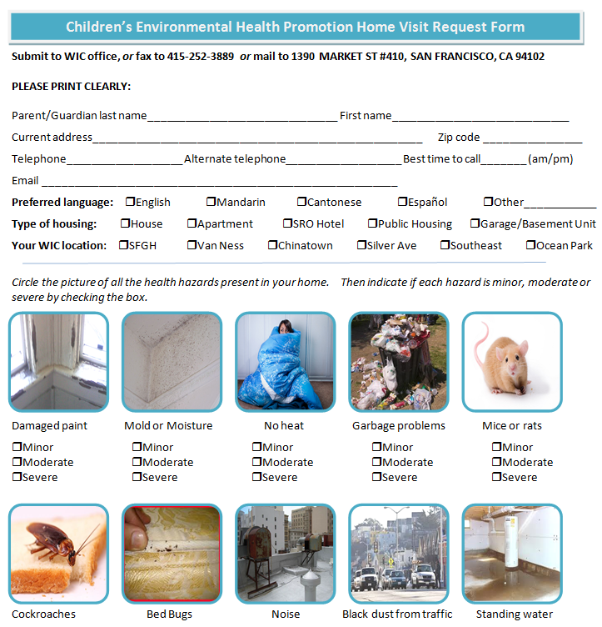
Notes:
I will now to switch to talking about some of the environmental hazards we see.
We partnered with our WIC program to mail their 15,625 clients an offer for free environmental home assessment
We have performed approximately 180 home visits to date.

Slide 7
of 20
Notes:
The environmental hazards most often found by our staff during WIC visits have been: lead hazards; cockroaches; mold; rodents.
It is no surprise to us that lead hazards are in the lead, because approximately 90% of SF housing units have lead based paint and the majority of our lead hazard inspections find violations.
We appreciate being able to do proactive lead hazard inspections as part of the WIC home service, instead of using children as canaries and waiting for a blood lead level to be reported.

Slide 8
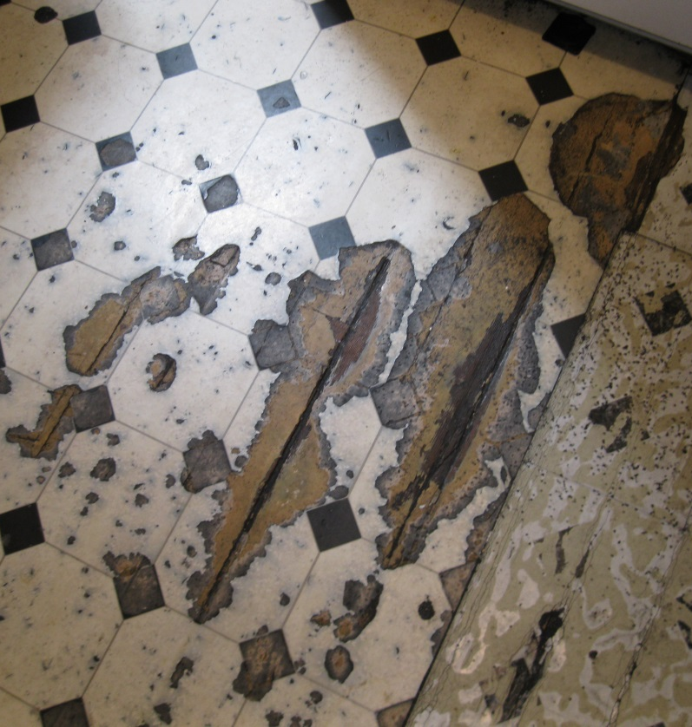
Notes:
Not in the tenant’s control

Slide 9
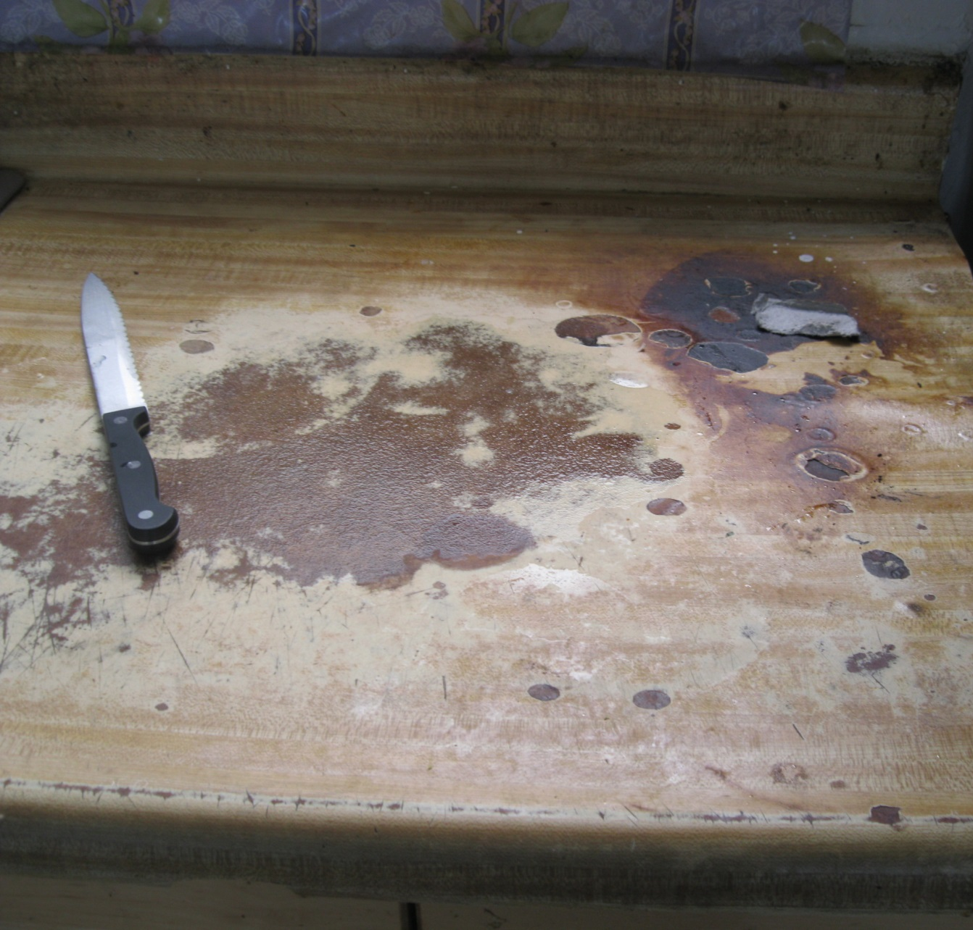
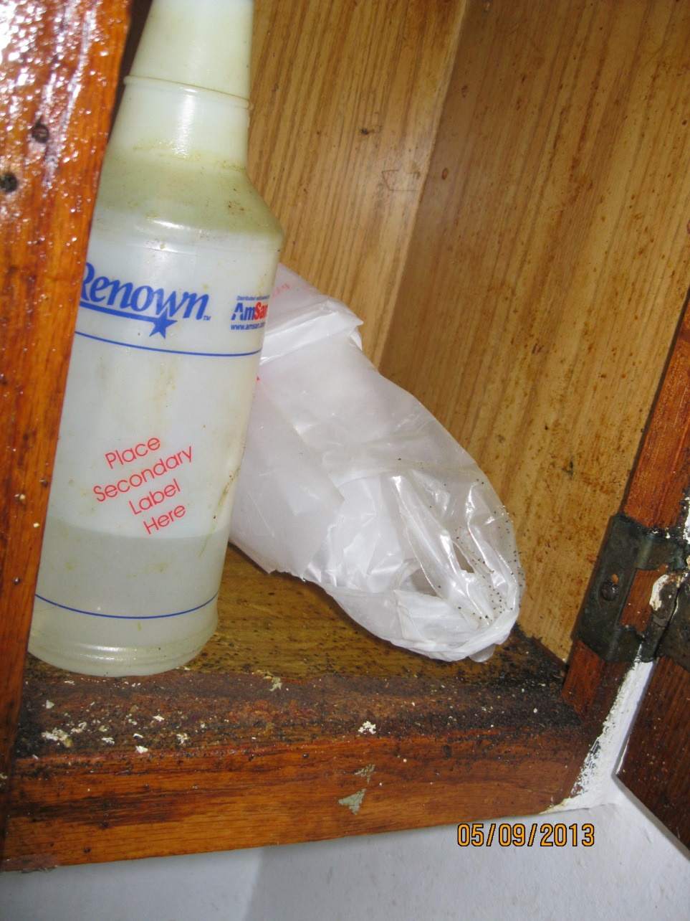
Notes:
Left, not in the tenant’s control
Right, pest feces present, a shared responsibility, owner must eliminate pest entry points and control infestations, while at same time tenant must make sure their practices do not attract pests

Slide 10
Notes:
Same idea—owner must eliminate pest entry points and pest harborage; tenant has done a good job of storage with tightly lidded containers.

Slide 11
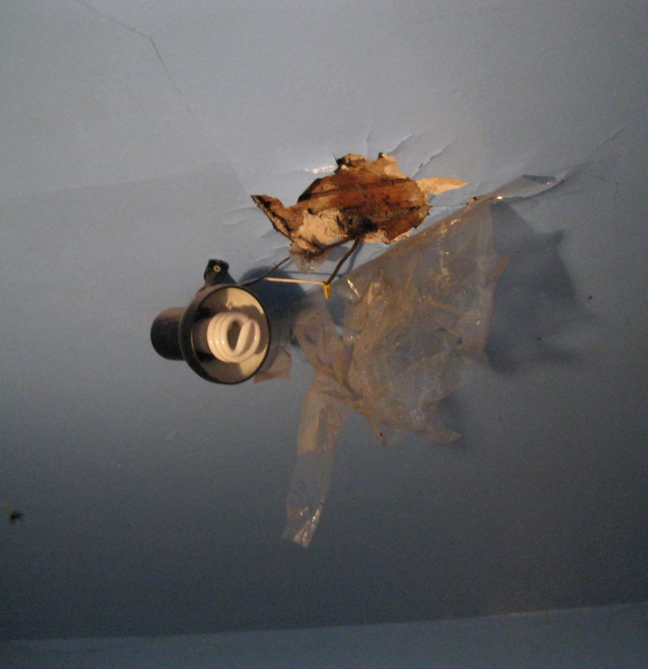
of 20
Notes:
Owner required to provide safe heating source, safe electrical, no holes in walls, floors and ceilings.
These would be referrals to DBI for their enforcement.

Slide 12
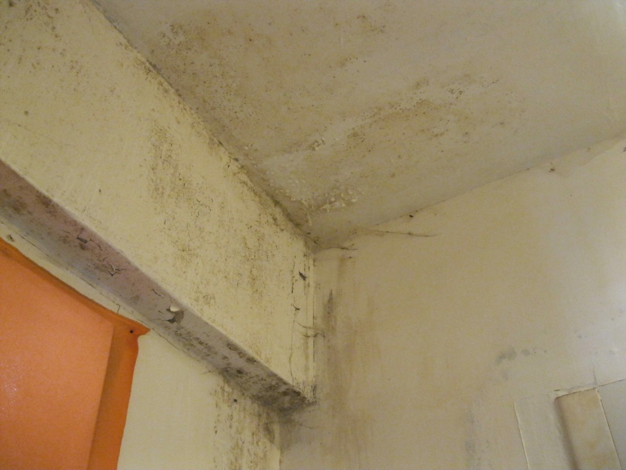
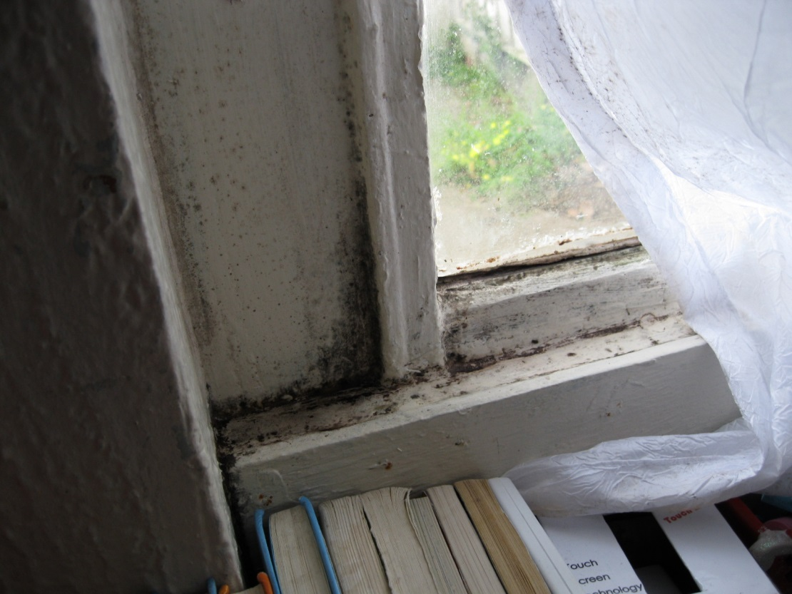
of 20
Notes:
Beyond tenant’s control, owner needs to identify and remedy moisture infiltration issues.

Slide 13
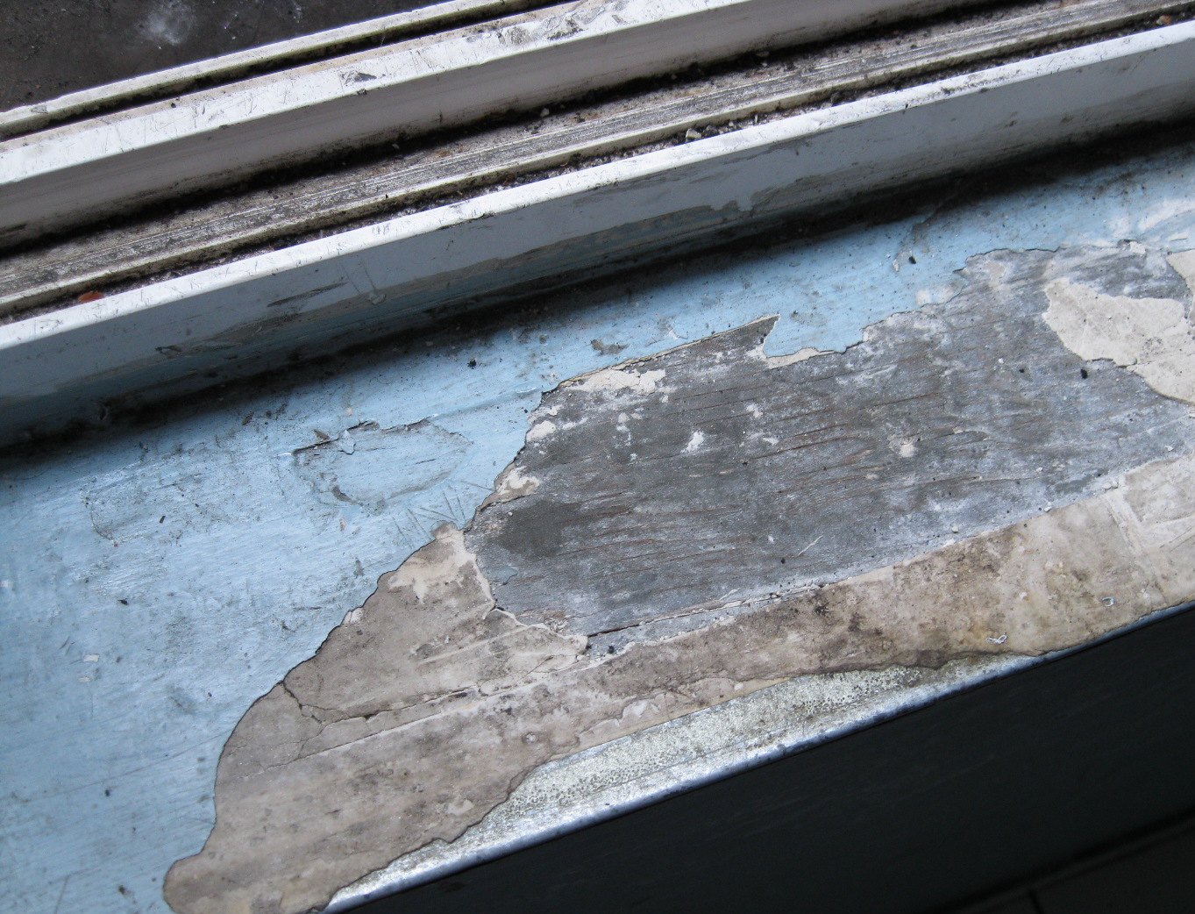
Notes:
Beyond tenant’s control, owner needs to safely repair and reseal lead-painted door jambs and window sills.
We will require use of state lead- certified contractors and state lead-certified risk assessor clearance test at completion.

Slide 14
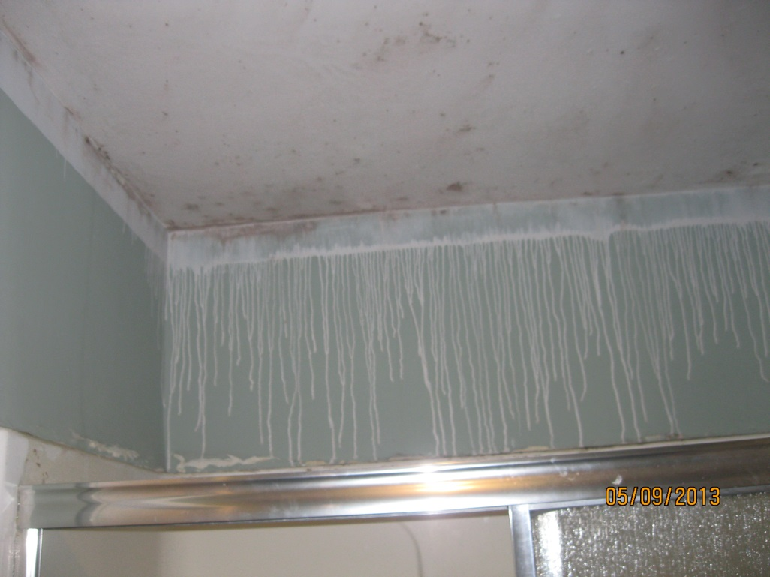
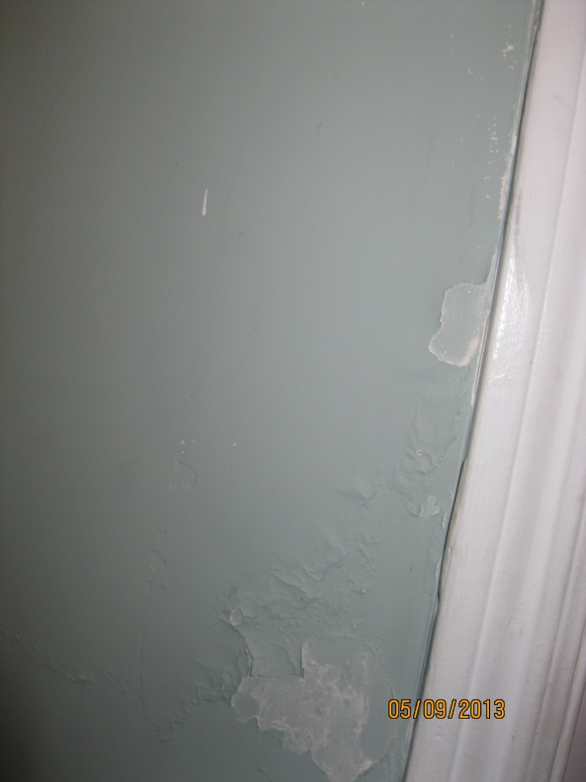
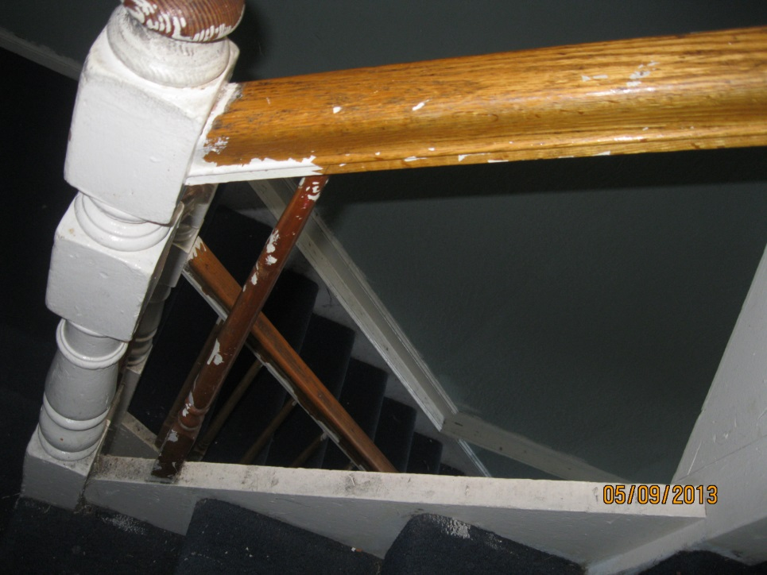
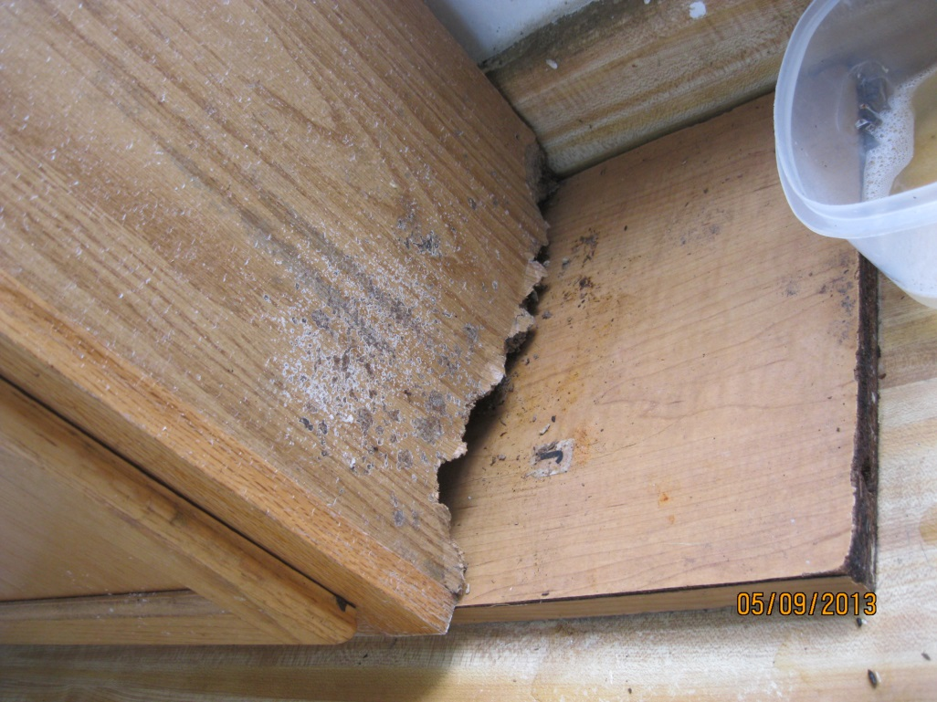
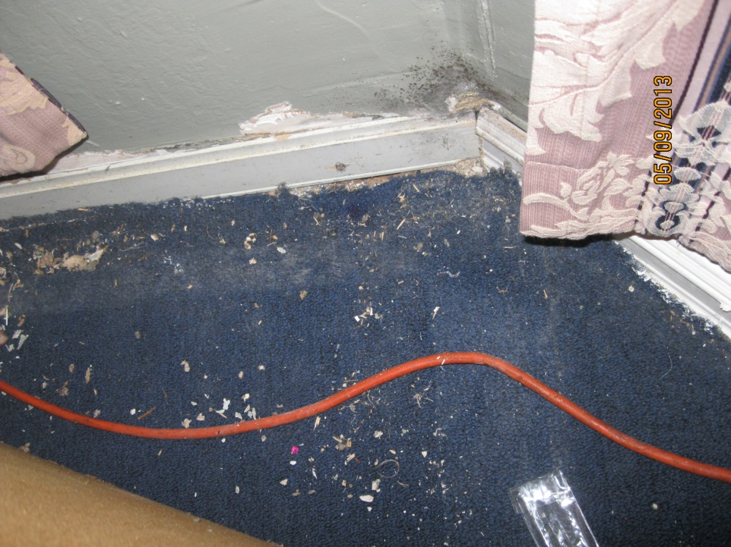
Notes:
Inspector found all these hazards (and more) at one address and issued a Notice of Violation:
Moisture causing mold (top left) and paint damage (top middle);
Bannister with safety hazards;
Rodents chewing away the bottom of cabinets and baseboards;
Mold and lead paint debris.

Slide 15
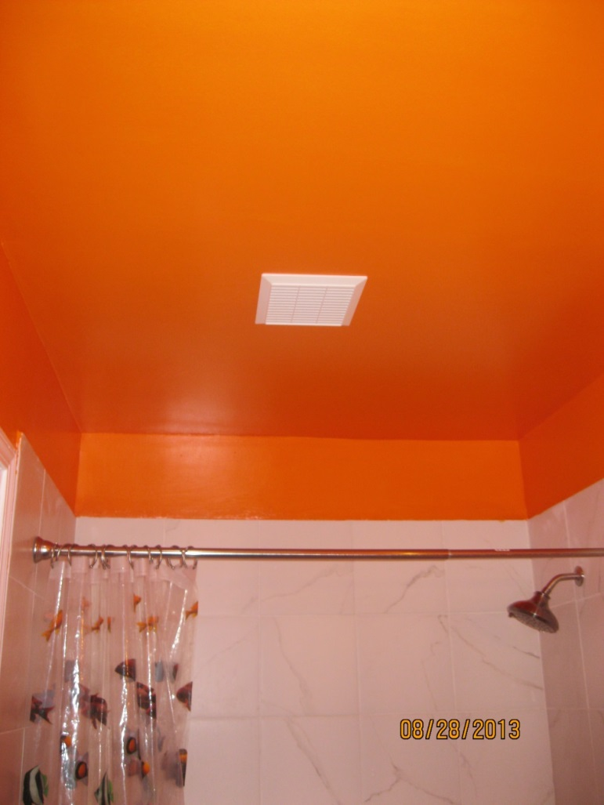
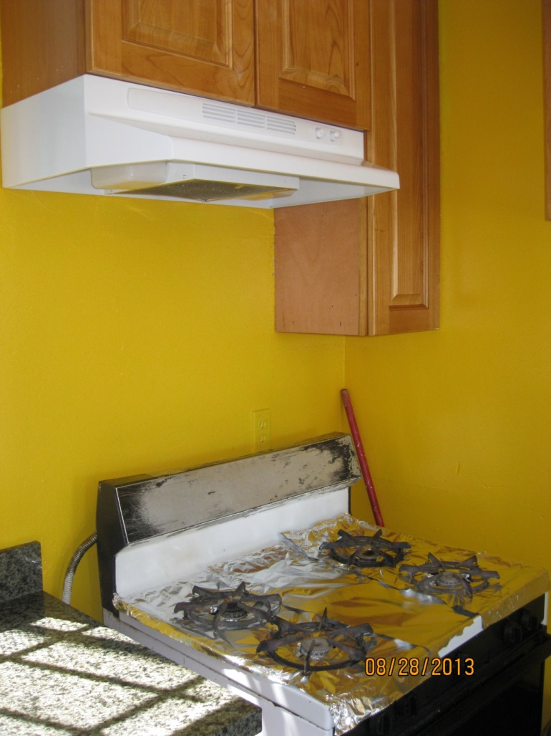
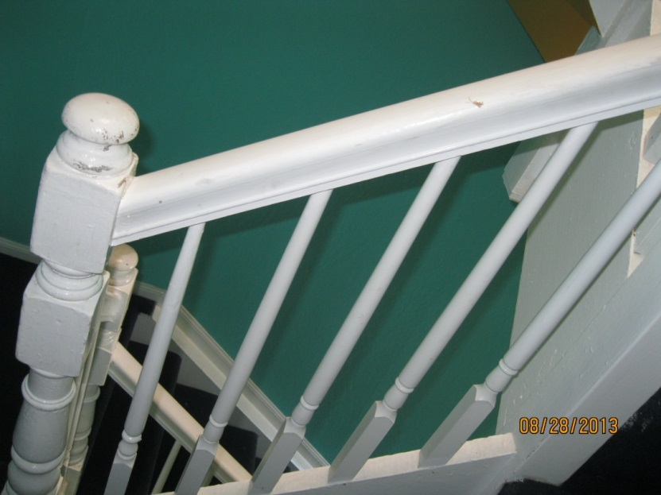
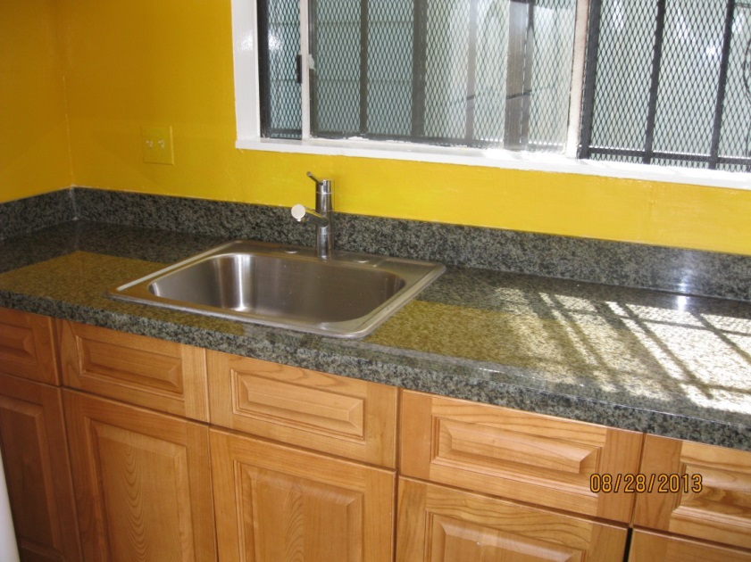
Notes:
Owner complied in a meaningful way, with this beautiful result.

Slide 16
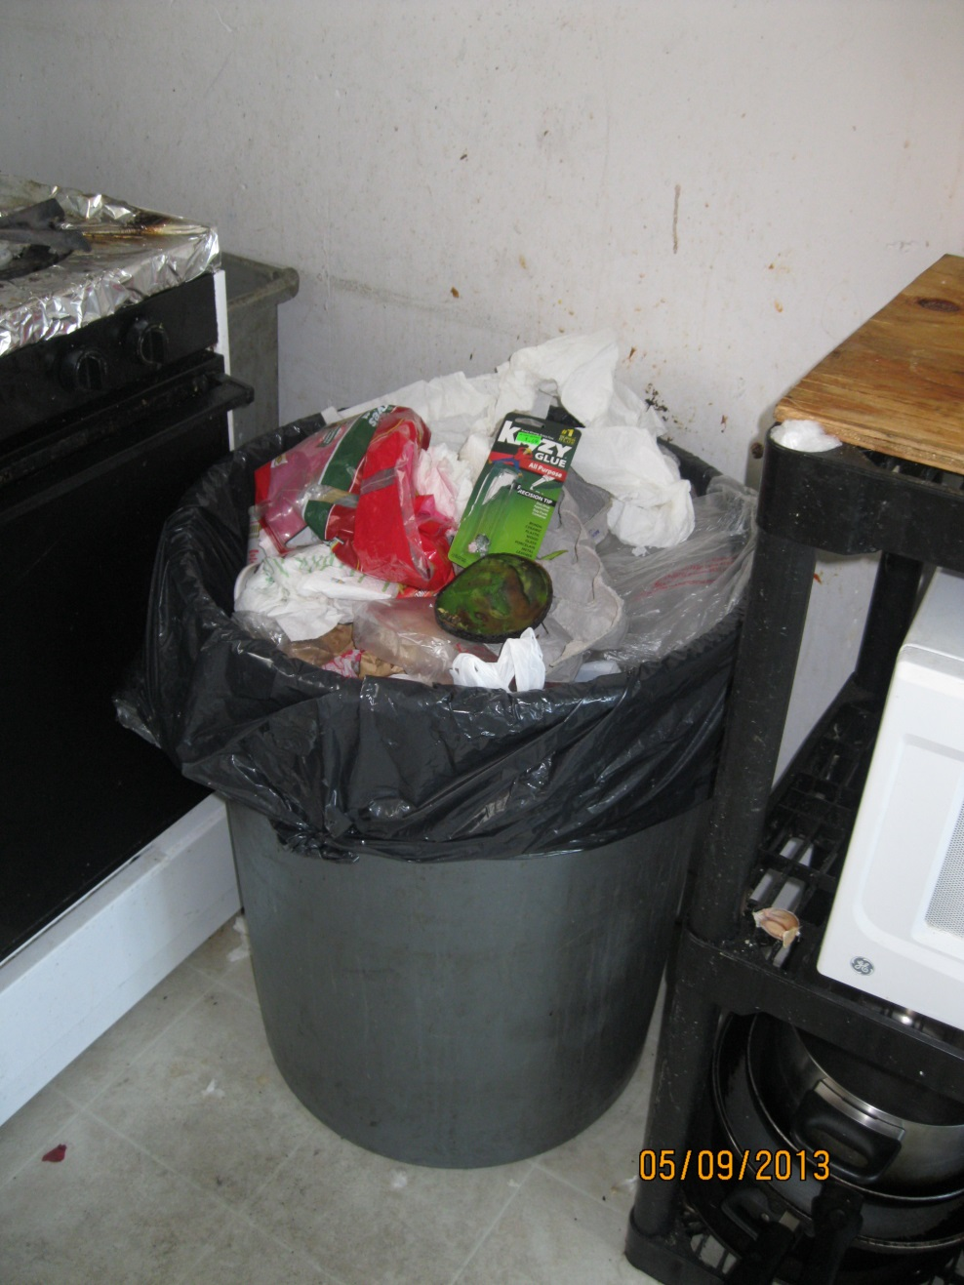
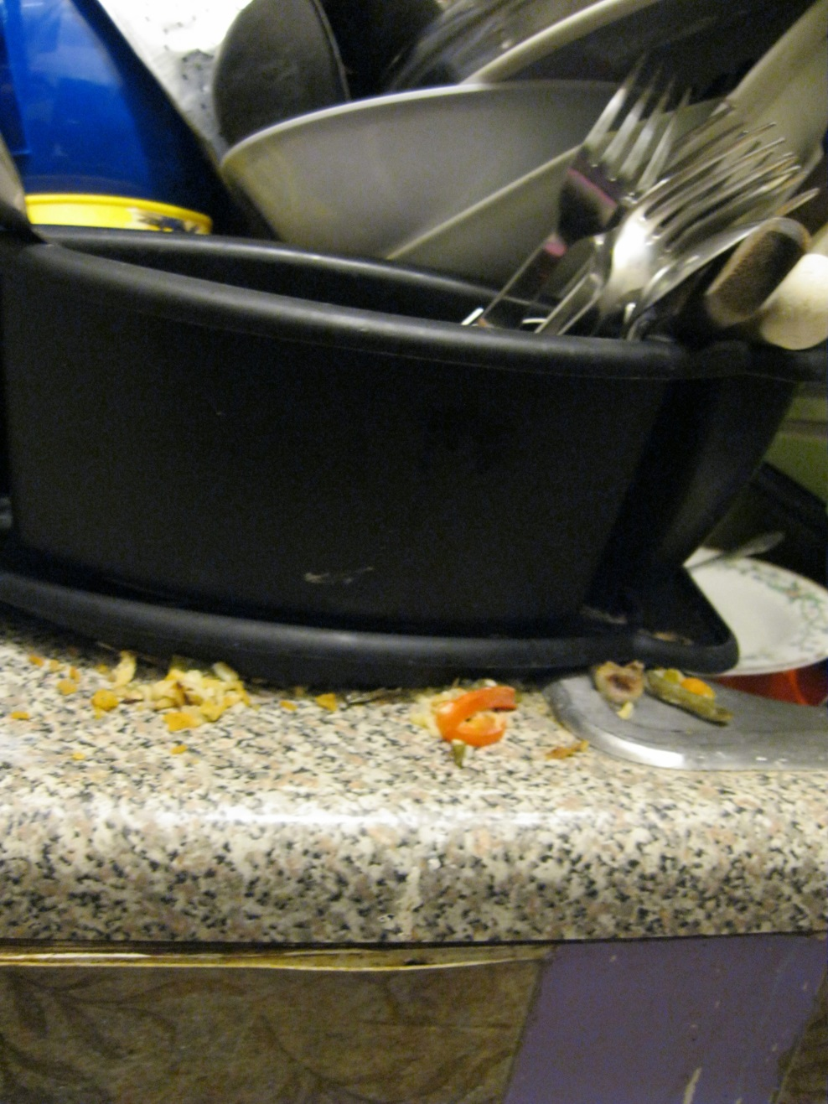
Notes:
We must acknowledge that families and co-tenants also contribute to hazards.
At the end of my presentation, I will show you a video we produced in three languages to help motivate families to be willing to speak to, or at times confront, their co-tenants to work together towards the goals of mold and pest prevention.

Slide 17
311
311 is for City agency-provided services.
Free. Multilingual. Available 24/7.
Anonymous complaints allowed.
of 20

Slide 18
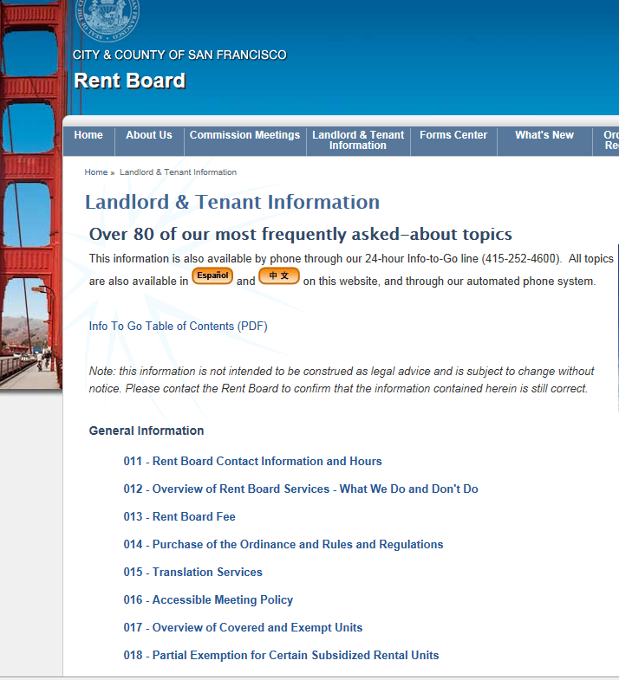
http://sfrb.org/
especially:
http://sfrb.org/index.aspx?page=4
of 20

Slide 19
211
211 is for social services, such as help with finding:
food
emergency housing
health care
child care
legal aid and much more
Free. Confidential. Multilingual. Available 24/7.
of 20

Slide 20
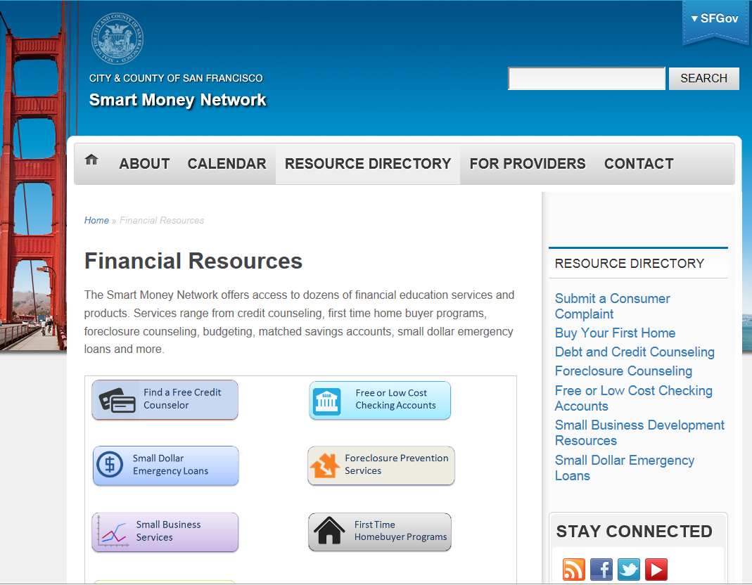
sfsmartmoneynetwork.org
or http://sfgov.org/smn/

