Slide 1
Department of Police Accountability
Budget Proposal
FY 2021-22 & FY 2022-23
Notes:
•DPA

Slide 2
DPA Mission and Vision
Mission
Vision
The Department of Police Accountability (DPA) is committed to providing the City of San Francisco with independent and impartial law enforcement oversight through investigations, policy recommendations, and performance audits to ensure that the Department reflects the values and concerns of the community it serves.
DPA as a national standard for independent civilian oversight of law enforcement
•Accessible, transparent, and engaged with community members
•Strong reputation as a trusted and credible agency providing high quality investigations and timely independent investigations and audits
•Quality of reporting (evidence based, leveraging a balance of qualitative and quantitative data)
Notes:
•Slalom

Slide 3
Mayor's Budget Instructions
In response to instructions from the Mayor’s Office, the DPA proposes reductions to its salary and benefits, programmatic, and non-personnel budgets.
The salary and benefits reduction will be achieved through attrition, keeping vacant positions unfilled.
Criteria
Maintain core functions and minimize impacts or delays to services to the community
Preserve current staffing levels and retain existing staff
Prioritize programs and services that promote racial equity
Reduce General Fund support by 7.5%, and identify an additional 2.5% reduction for contingency.
Notes:
•Slalom

Slide 4
Department Proposed Budget
Total Budget
 | Base Budget FY2021-22 | Proposed Budget FY2021-22 | Proposed Budget FY2021-22 w/ Contingency
Total | $9,733,157 | $ 9,212,050 | $ 9,038,348
Change |  | - $521,107 | - $173,702
Positions (FTE)
 | Base FTE FY2021-22 | Proposed FTE | Proposed FTE w/ Contingency
Total | 45 | 43 | 42
Change |  | -2 | -1
Notes:
•Slalom

Slide 5
Department Proposed Budget by Category
FY 2021-22
Category | Change from Base | Change from Base w/ Contingency
Salary & Benefits | - $418,565 | - $583,521
Programmatic Project | - $60,000 | - $60,000
Non-personnel Services | - $42,542 | - $51,288
Total | - $521,107 | - $694,809
Notes:
•Slalom

Slide 6
Reduction Impact
The DPA is witnessing increasing numbers of annual complaints. Currently, investigator caseloads are almost double the Controller’s recommended level.*
* Controller’s Office 2007 OCC Audit
The DPA will continue to investigate complaints against the Sheriff’s Office. Under a proposed revised Letter of Agreement, the DPA will not only accept investigative referrals from the Sheriff’s Office but will also increase jurisdiction by receiving complaints directly from the public and outside agencies. The DPA will support this expanded scope of work with existing staffing and resources, which will further stress increased caseloads.
The DPA will continue to face the significant administrative needs required by SB1421, a landmark police accountability transparency law. To satisfy disclosure requests already received and new requests, the DPA projects completion after 9 years using existing staff assigned to this function. Additionally, the adoption of proposed SB776, which broadens the categories of disclosable cases, would further increase the administrative work required to disclose qualifying files. Temporary positions were added in last year’s budget. These positions are critical to support this ongoing and expanding workload.
The DPA endeavors to conduct a biased policing audit under its charter-mandated authority to conduct periodic audits of the San Francisco Police Department. The DPA will leverage existing department and City resources to perform this project to support the Mayor’s budget reduction requests.
Notes:
•Slalom

Slide 7
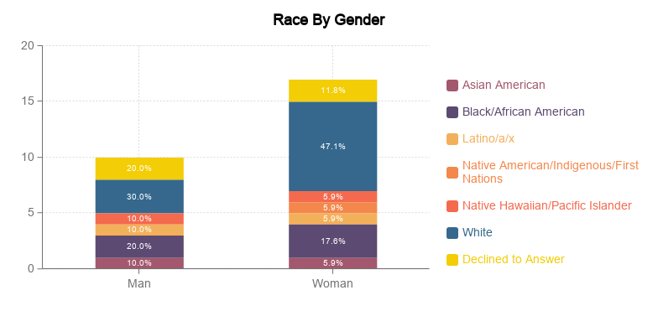
Equity in DPA Staff by Gender
*Data from CY 2020
Notes:
•Slalom

Slide 8
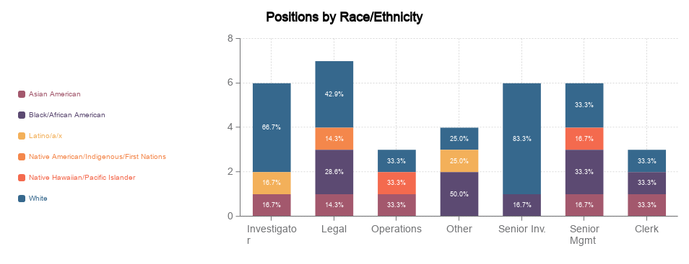
Equity in DPA Staff by Race/Ethnicity
*Data from CY 2020
Notes:
•Slalom

Slide 9
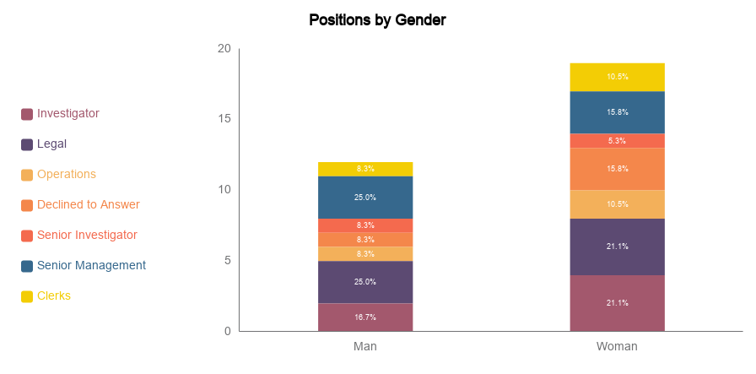
Equity in DPA Staff by Gender Across Positions
*Data from CY 2020
Notes:
•Slalom

Slide 10
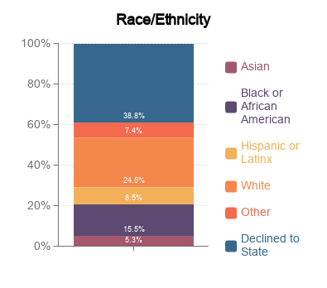
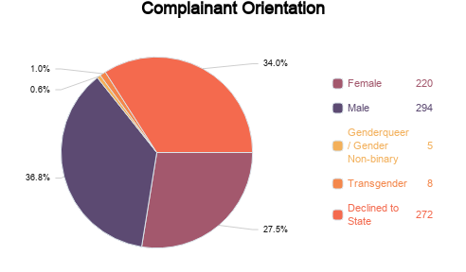
Equity in DPA Complaint Investigations
Complaints | Number | Percent
Complainants | 764 | 98%
Anonymous | 35 | 2%
*Data from CY 2020
Notes:
•Slalom

Slide 11
DPA Budget and Racial Equity
Bottom Line: The DPA Budget proposal does not adversely affect the department's racial equity priorities.
Internal: The DPA will continue to use existing programs and resources (SharePoint, DHR Training, internal groups) to promote equity in our department.
External: The DPA will not amend the existing complaint and investigation process.
Link to the DPA's Racial Equity Action Plan: https://my.visme.co/view/y4mwqnwz-racial-equity-project
Notes:
•Slalom

